Slide 1
2025–26 FAFSA® Preview Presentation
October 2024

Slide 2
Topics
Overview
Dependent Student Invites Parent
Parent Starts and Submits a FAFSA® Form Without Student Consent and Approval or Signature
Independent Student Invites Student Spouse
Independent Student Who Is Single and a Non-Tax Filer
FAFSA Submission Summary
Dependent Student and Direct Unsubsidized Loan
Unaccompanied Homeless Youth
Provisionally Independent Student
Student Adds Schools to FAFSA® Form
Student Submits a FAFSA® Correction to Homeless Determination
Student Manages FAFSA® Contributors
Parent Submits a Required FAFSA® Correction for Missing Consent and Approval

Slide 3
Overview (1 of 4)
The 2025–26 Free Application for Federal Student Aid (FAFSA®) Preview Presentation provides screenshots that financial aid professionals, mentors, and counselors can use as a guide for the 2025–26 online FAFSA form. The screenshots and information provided can be used to create and/or modify presentations for professional trainings and high school FAFSA completion nights.
The screenshots are intended to show what the FAFSA form will look like and present a majority of the questions displayed on the FAFSA form.
The 2025–26 version of the FAFSA form will become available by Dec. 1, 2024.

Slide 4
Dependent Student Invites Parent

Slide 5
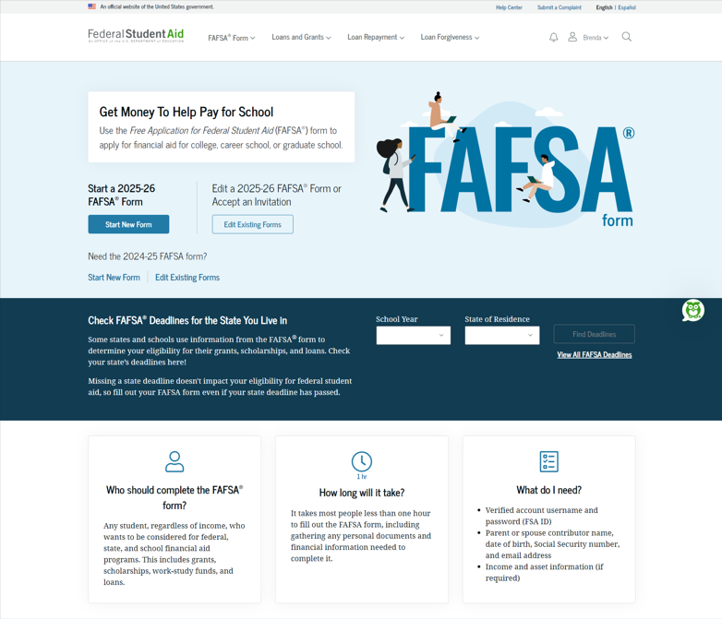
Dependent Student FAFSA® Landing Page
This is the main FAFSA® landing page. On this page, students are directed to "Start New Form" or “Edit Existing Forms." For this section of the presentation, the student is beginning a new application.

Slide 6
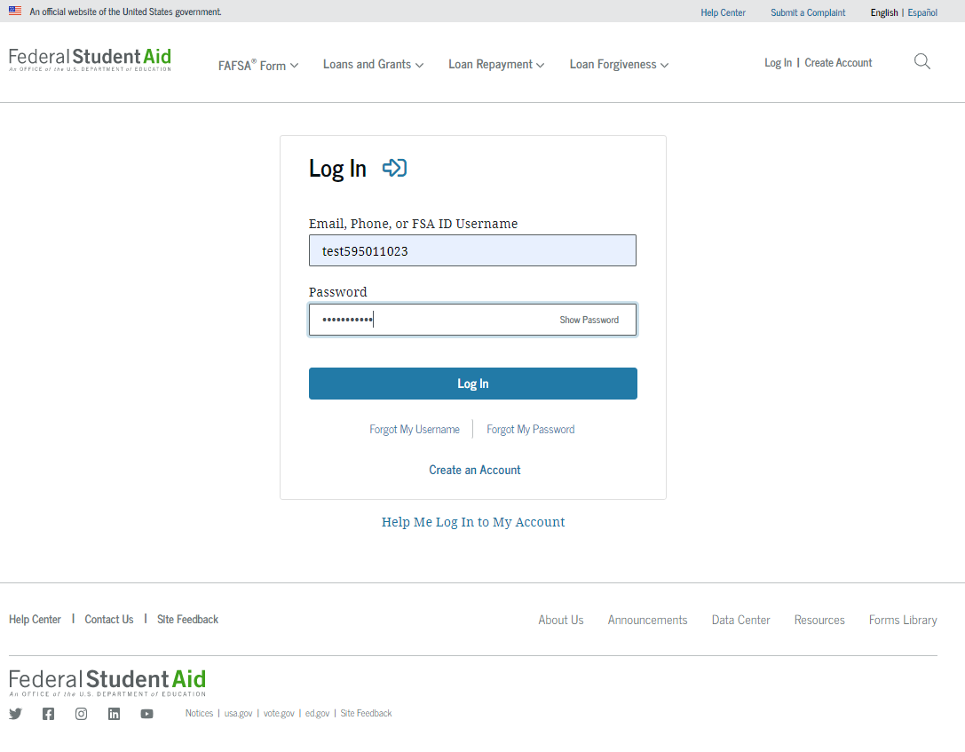
Dependent Student Log In
If the student selects "Start New Form" from the FAFSA® landing page and they are not logged in to StudentAid.gov, they are taken to the "Log In" page to enter their credentials. To access the FAFSA form, all students are required to have an FSA ID (StudentAid.gov account username and password). If the student doesn't have an FSA ID, they can select "Create an Account."

Slide 7
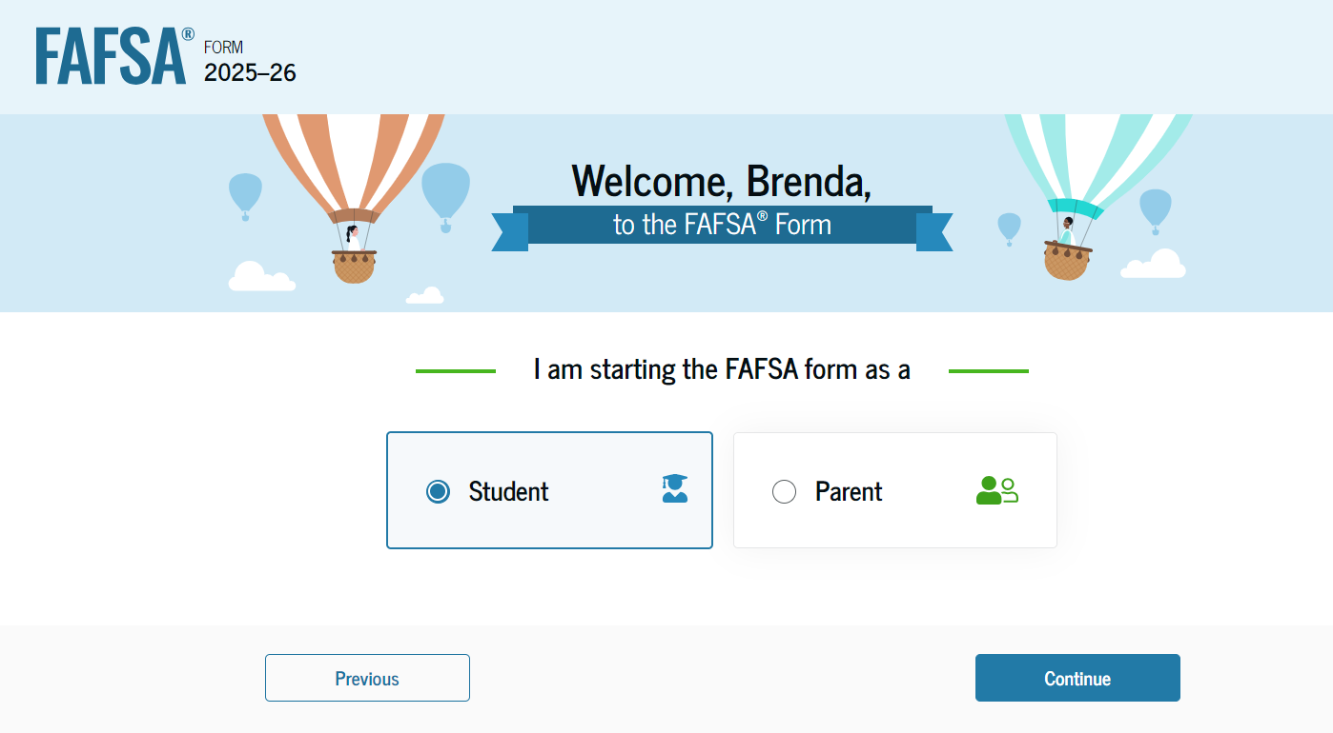
Dependent Student Roles
After logging in, the student can select the applicable role to fill out the FAFSA® form: "Student" or "Parent." The student selects "Student."

Slide 8
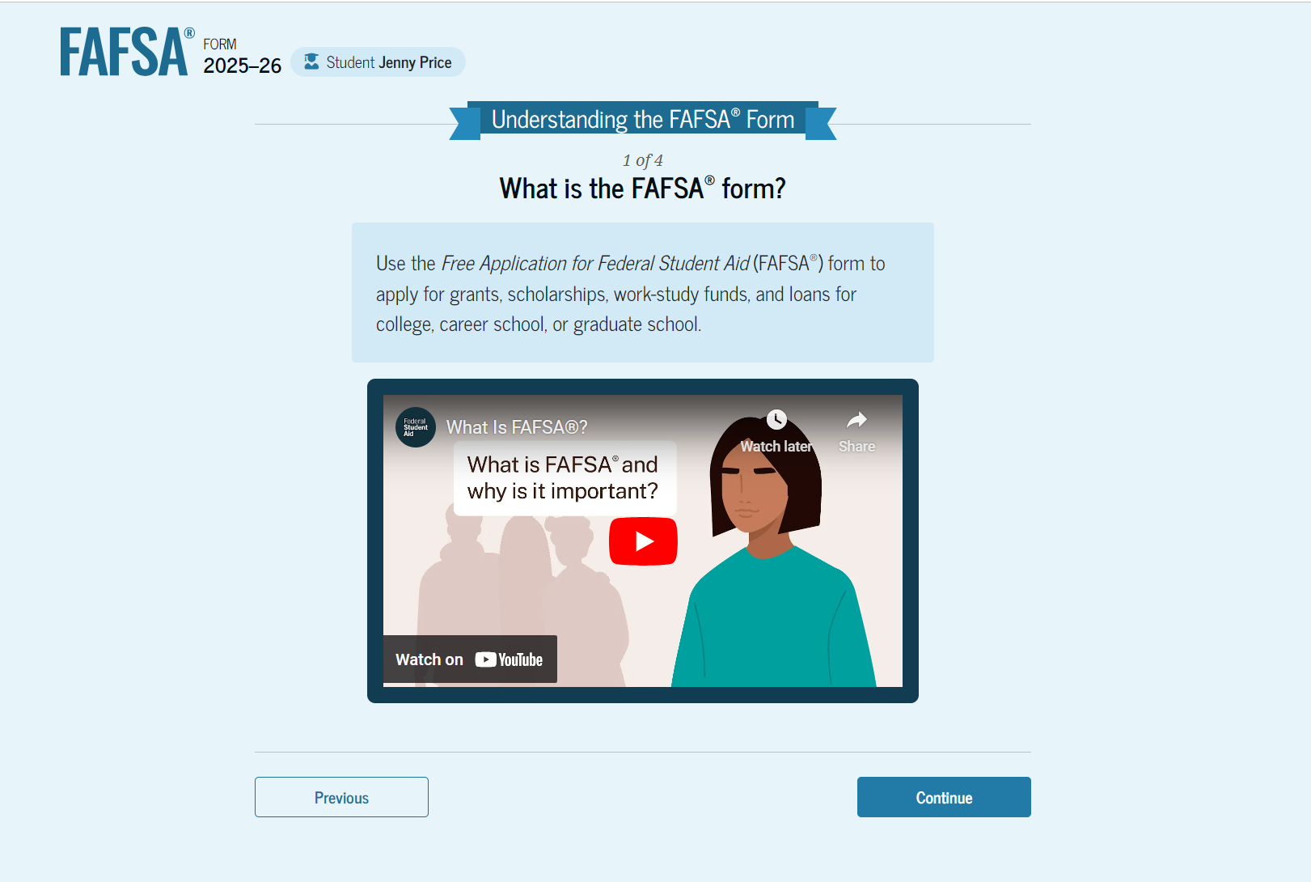
Student Onboarding (1 of 4)
When the student starts the 2025–26 FAFSA® form for the first time, they are taken through the FAFSA onboarding process. The first onboarding page provides an introduction of the FAFSA form and an accompanying video.

Slide 9
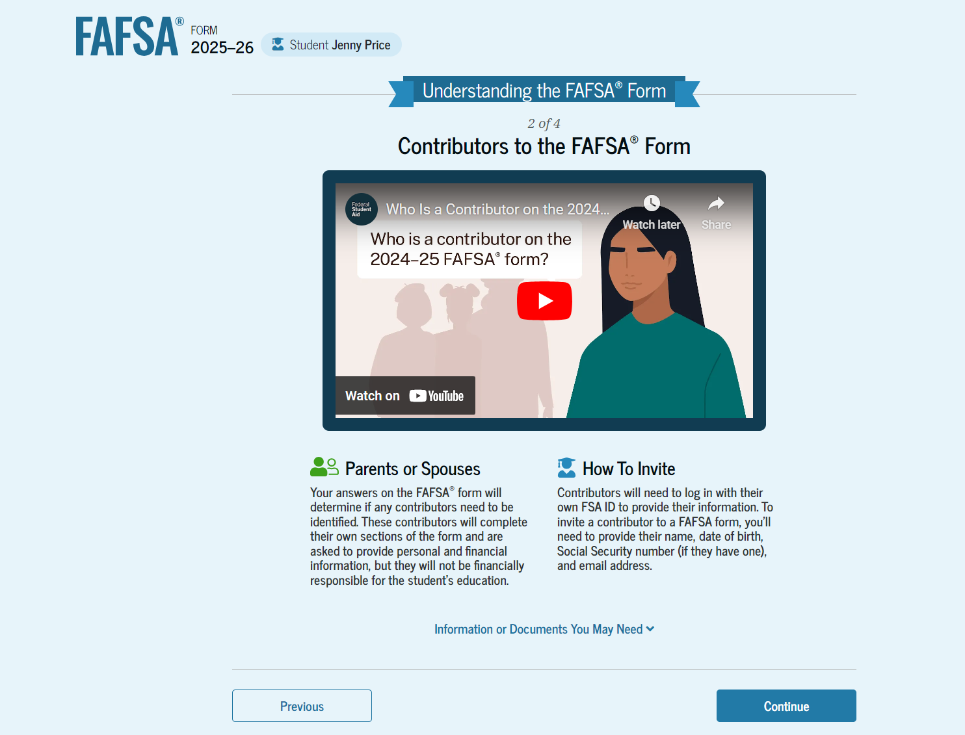
Dependent Student Onboarding (2 of 4)
The second FAFSA® onboarding page provides information about contributors that may be required to participate in the student’s FAFSA form, including an accompanying video that explains contributors, and information on how the student will invite them. Documents that may be needed to fill out the form are also included on this page.

Slide 10
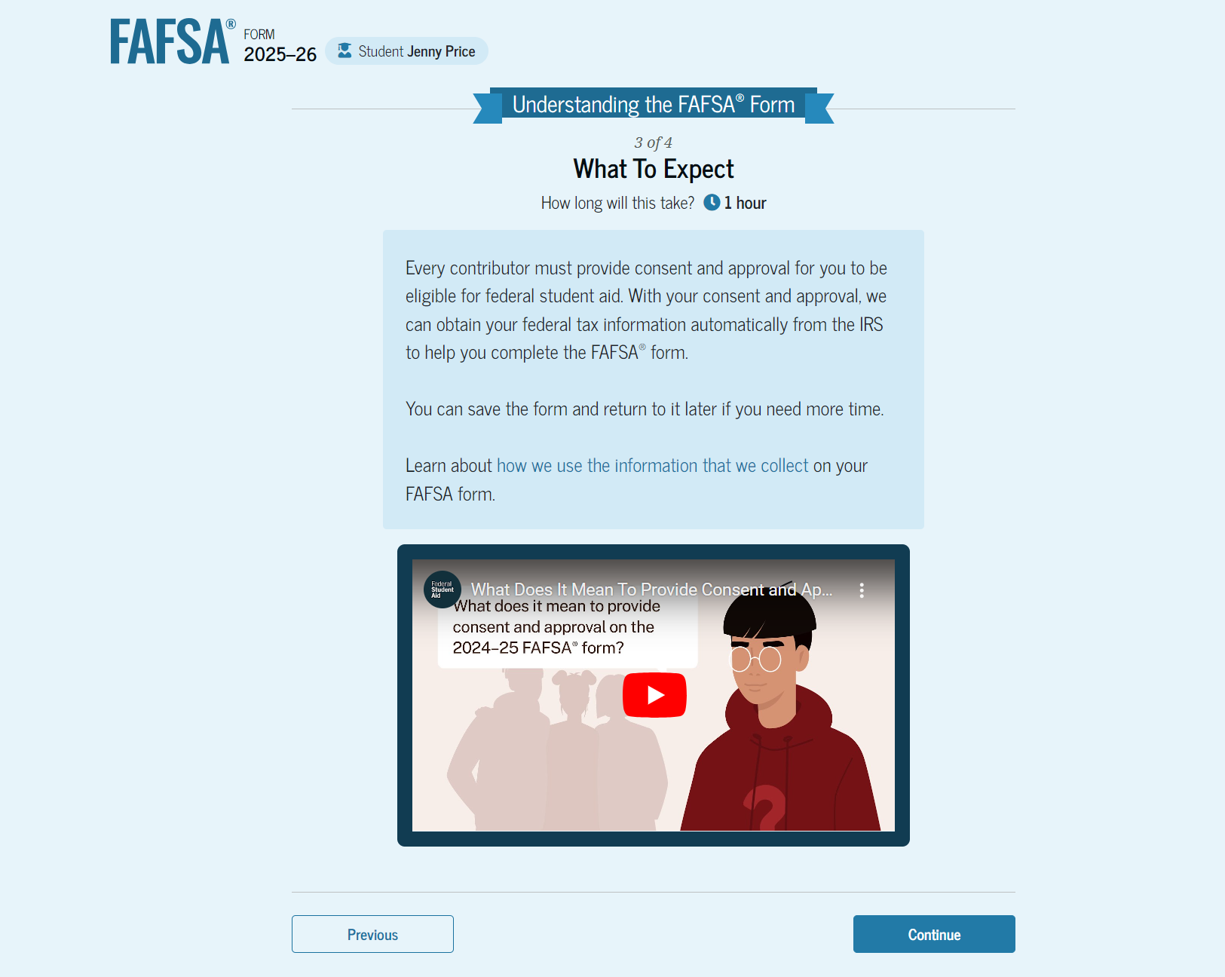
Dependent Student Onboarding (3 of 4)
The third FAFSA® onboarding page provides information about what the student can expect when completing their FAFSA form. This includes information about consent and approval, a time estimate for completing the form, and that they can save the form and return later if needed, along with an accompanying video.

Slide 11
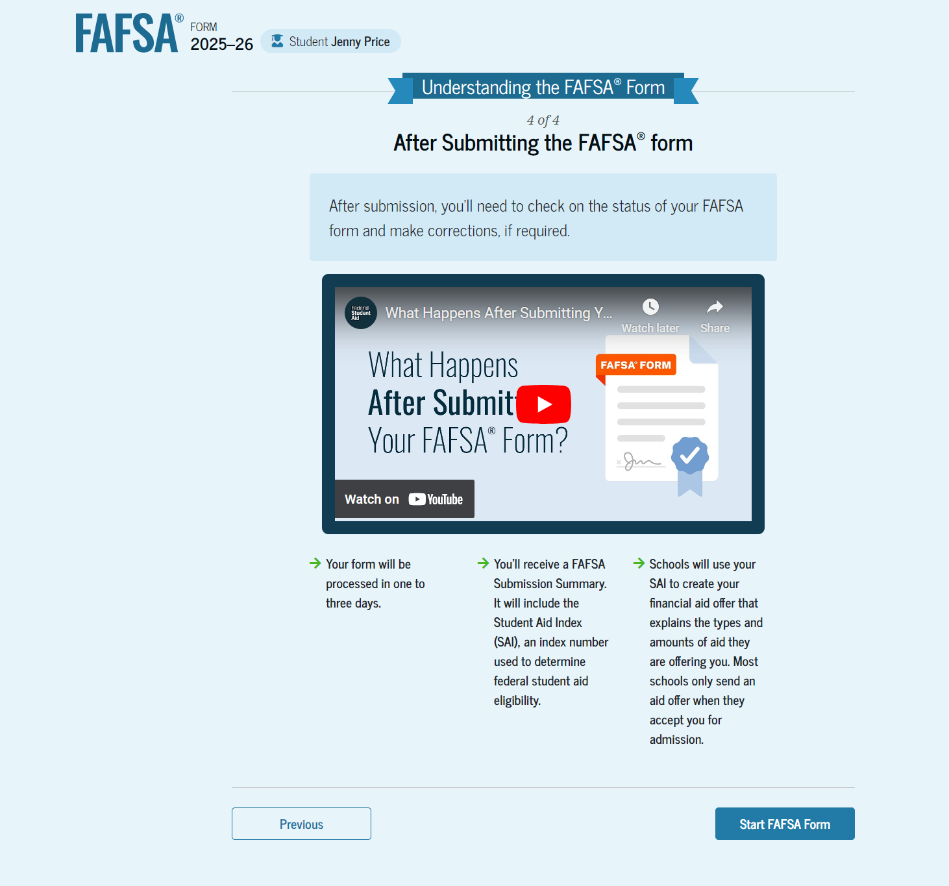
Dependent Student Onboarding (4 of 4)
The last FAFSA® onboarding page provides information about what to expect once the FAFSA form is completed, submitted, and processed. On this page, the student can select "Start FAFSA Form" to begin.

Slide 12
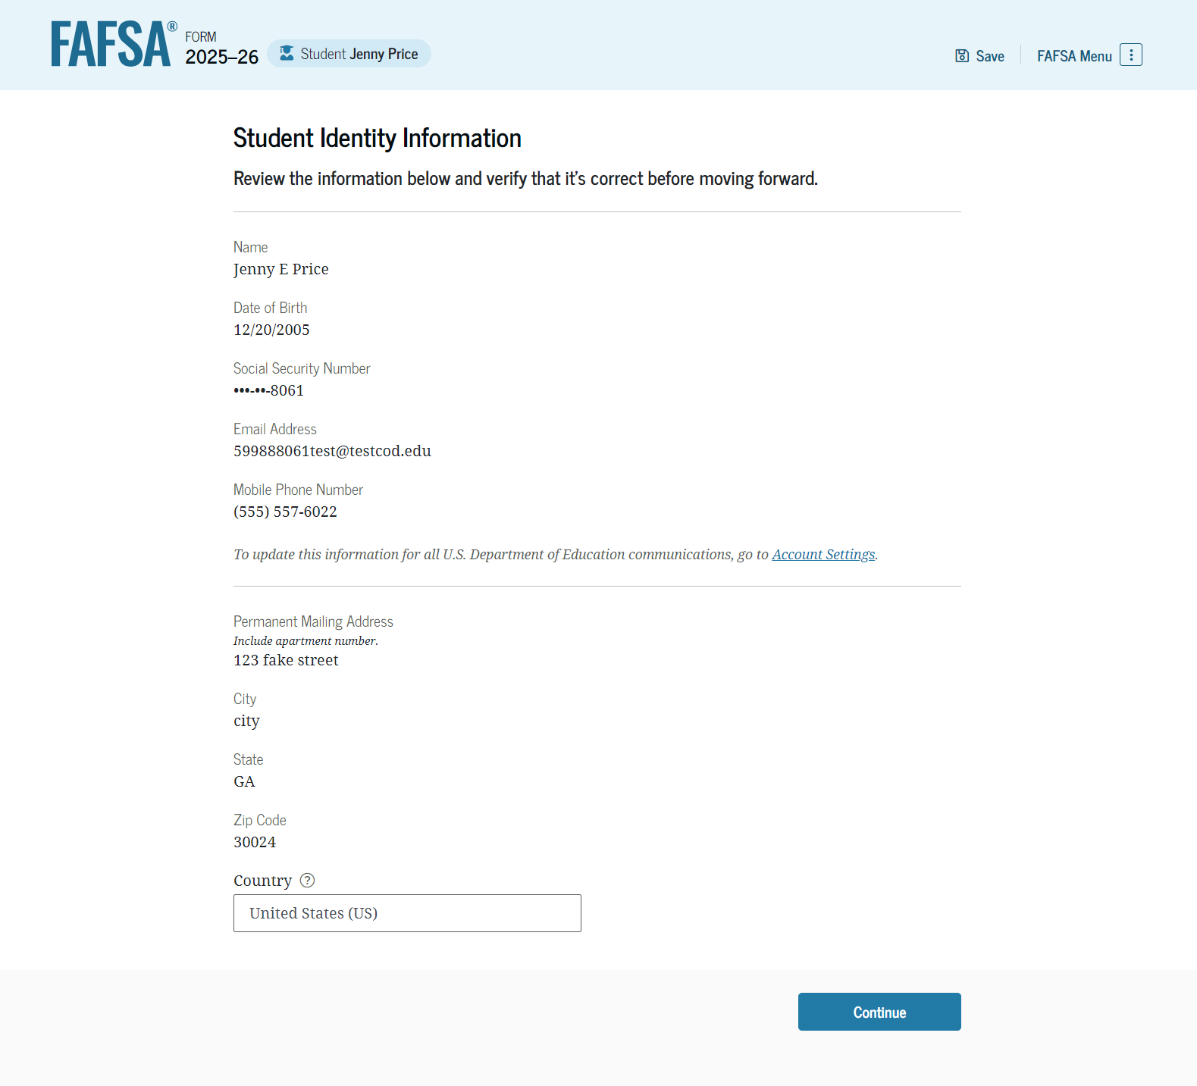
Dependent Student Identity Information
This is the first page within the student section. The student can verify that their personal information is correct. To update any of the personal information, the student must access their Account Settings on StudentAid.gov.

Slide 13
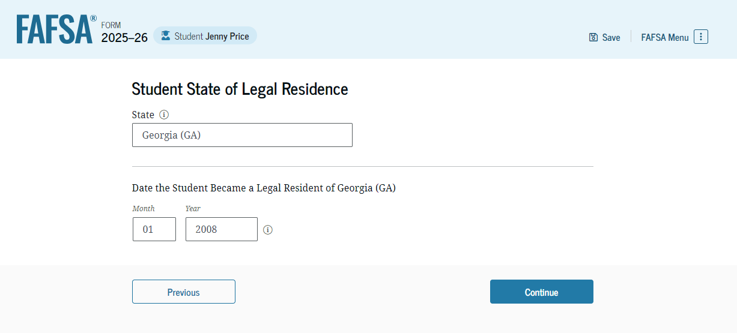
Dependent Student State of Legal Residence
The student is asked about their state of legal residence. The student selects the state from a drop-down box and provides the month and year when they became a legal resident.

Slide 14
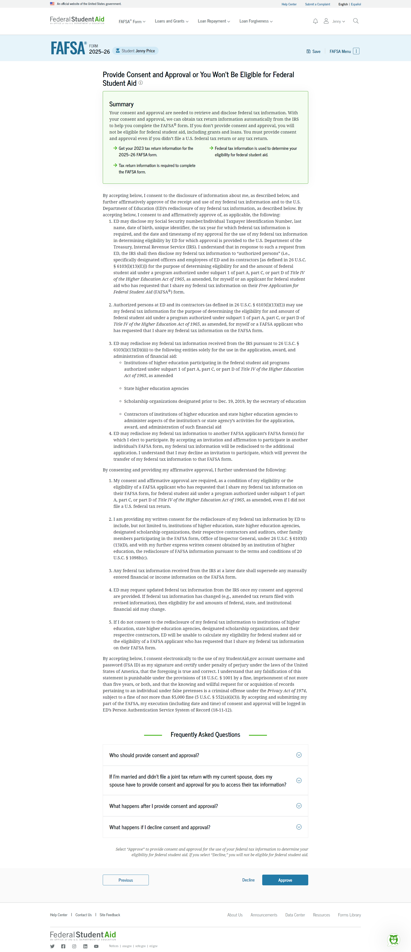
Dependent Student Provides Consent and Approval
This page informs the student about consent, approval, and the use of their federal tax information. By providing consent and approval, the student’s federal tax information is transferred directly into the FAFSA® form from the IRS to help complete the "Student Financials" section.

Slide 15
Dependent Student Provides Consent and Approval (Continued)
This is a continuation of the consent and approval page. Frequently asked questions about consent and approval are also provided that the student can expand and collapse. The student selects "Approve" to provide consent and approval, and they are taken to the next page.

Slide 16
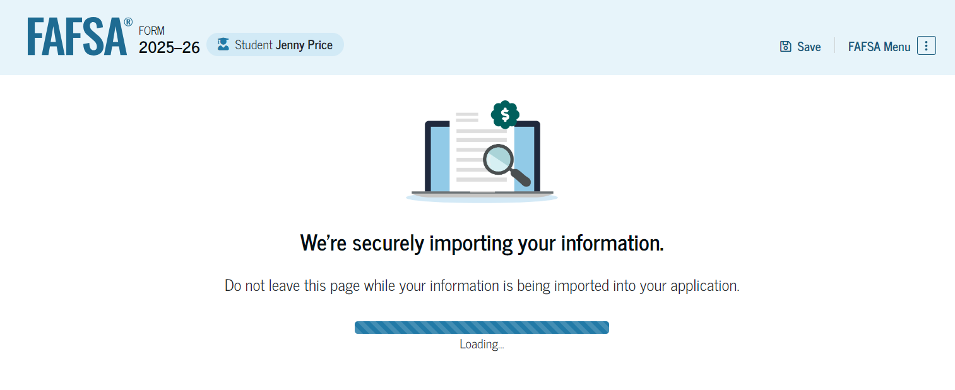
Dependent Student Imports IRS Information
This page imports the student’s federal tax information by directly transferring it into the FAFSA® form from the IRS to help complete the "Student Financials" section.

Slide 17
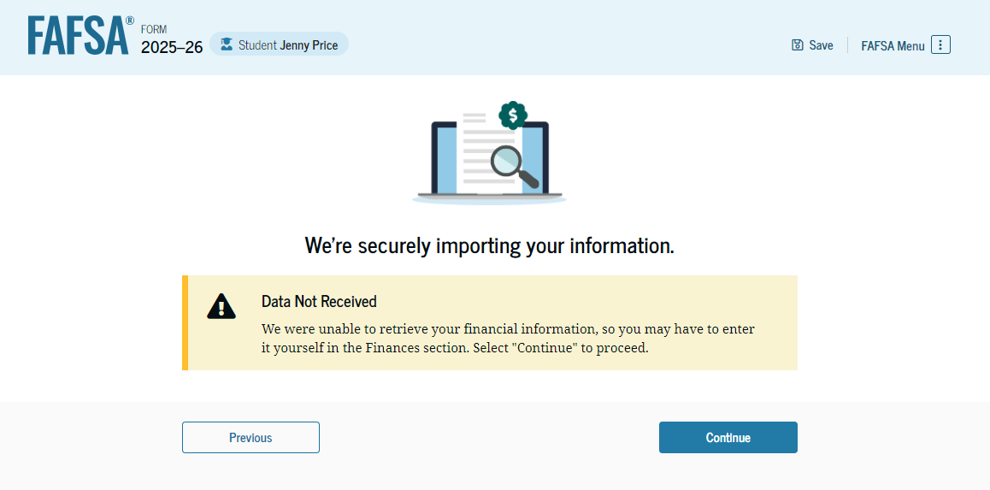
Dependent Student Imports IRS Information (Continued)
This page displays the results from the IRS import for the student. For this scenario, the student is starting a new FAFSA® form and there is no federal tax information available from the IRS.

Slide 18
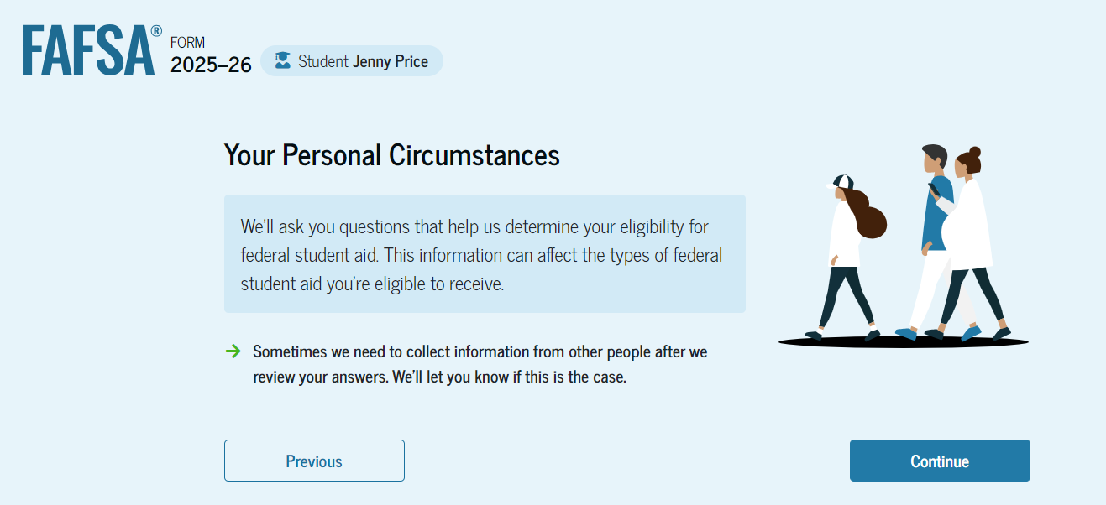
Dependent Student Personal Circumstances
This is the first page within the "Student Personal Circumstances" section. It provides an overview of the section.

Slide 19
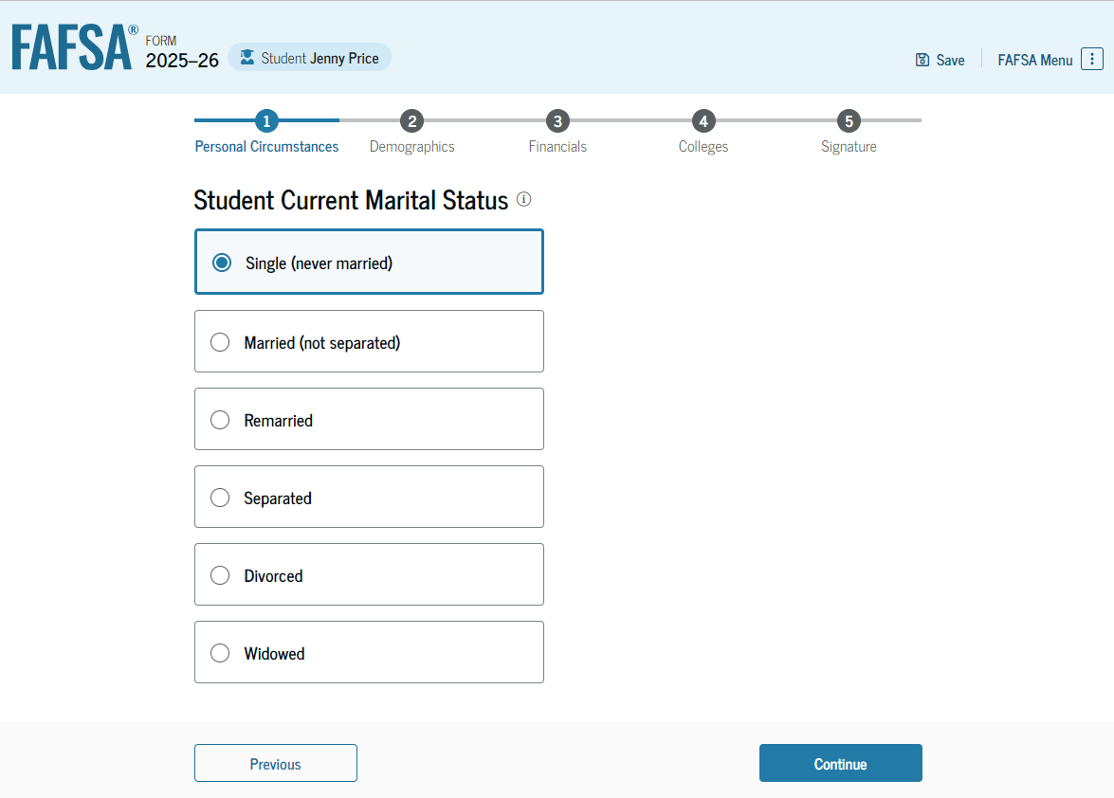
Dependent Student Marital Status
The student is asked about their marital status. The student selects the "Single (never married)" option.

Slide 20
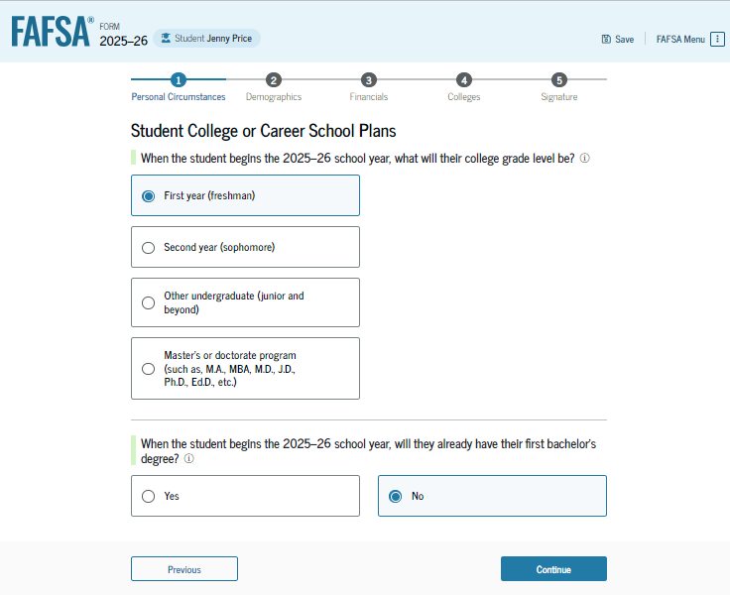
Dependent Student College or Career School Plans
The student is asked about their college grade level for the 2025–26 school year and if they will have their first bachelor’s degree. The student selects that they will be a "First year (freshman)" and that they will not have their first bachelor’s degree.

Slide 21
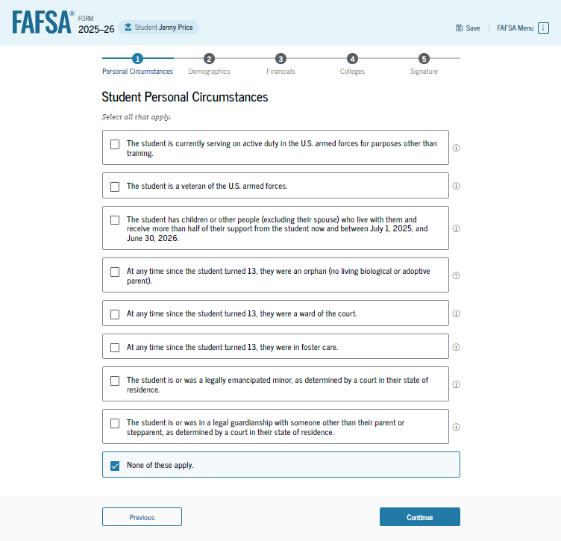
Dependent Student Personal Circumstances (Continued)
The student is asked if any of the listed personal circumstances apply to them. The student selects "None of these apply."

Slide 22
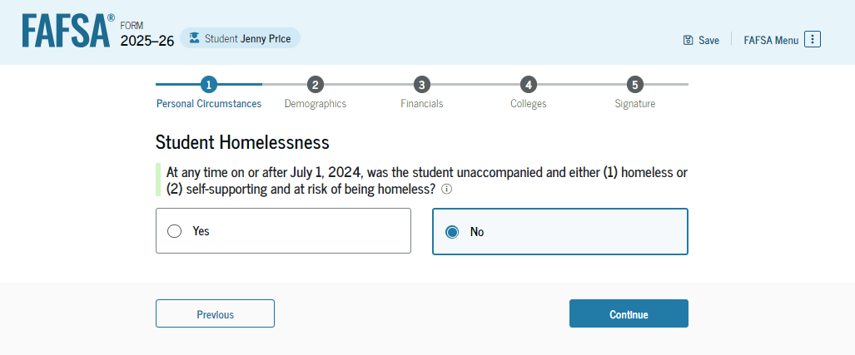
Dependent Student Homelessness
The student is asked if they were homeless or at risk of being homeless. The student selects "No."

Slide 23
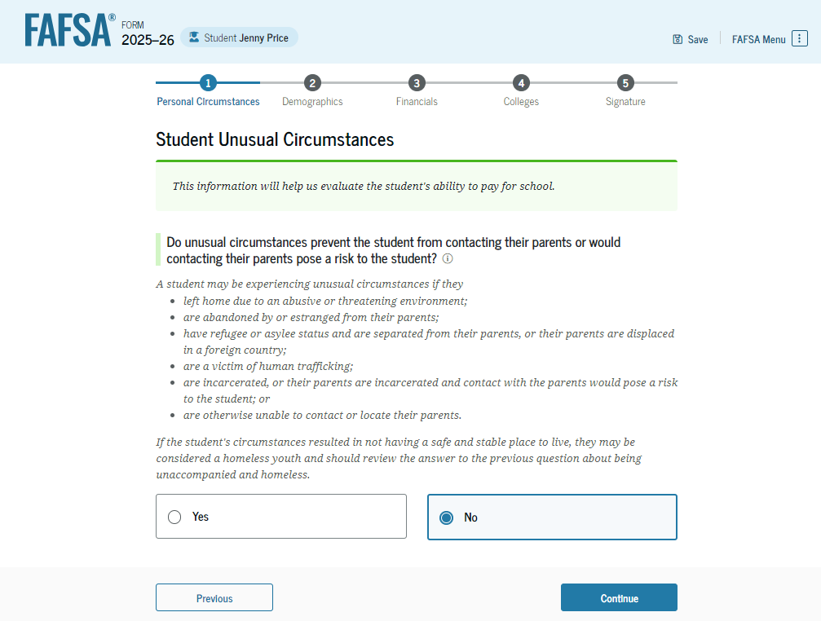
Dependent Student Unusual Circumstances
The student is asked if unusual circumstances prevent them from contacting their parent(s). The student selects "No."

Slide 24
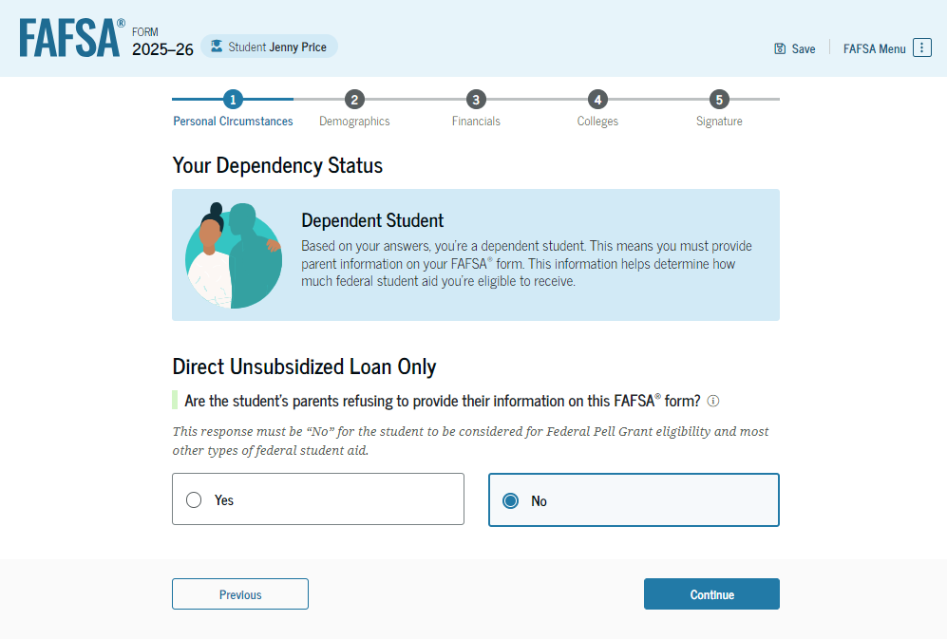
Student Dependency Status: Dependent Student
Based on the answers provided by the student, they are considered a dependent student. The student is asked if they want a financial aid administrator to determine their eligibility for a Direct Unsubsidized Loan only. This is an option if the student’s parents are unwilling to provide information. The student selects "No,“ and if the student had selected “Yes,” a modal would appear to warn them about missing out on other potential federal student aid.

Slide 25
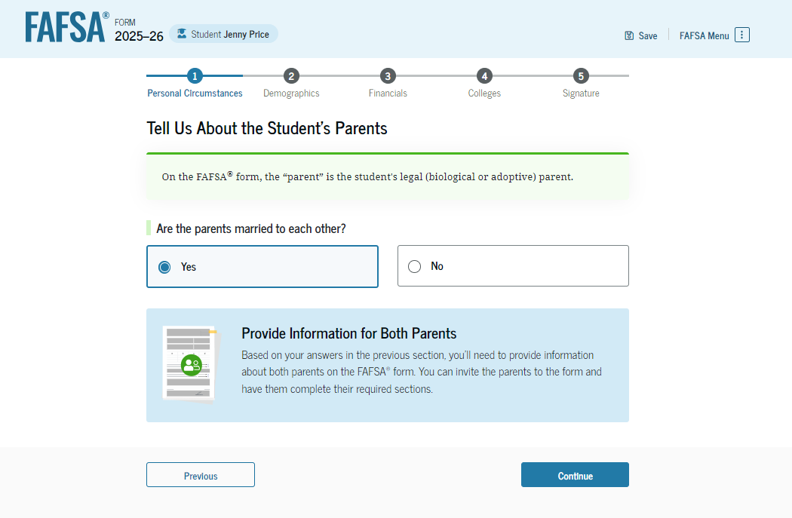
Dependent Student: Tell Us About Your Parents
As the student is considered dependent, they are asked to provide information about their parents. The FAFSA® form considers their “parent" to be their legal (biological or adoptive) parent. The student is asked if their parents are married. The student selects "Yes" and is instructed to provide information about both their parents on the FAFSA form.

Slide 26
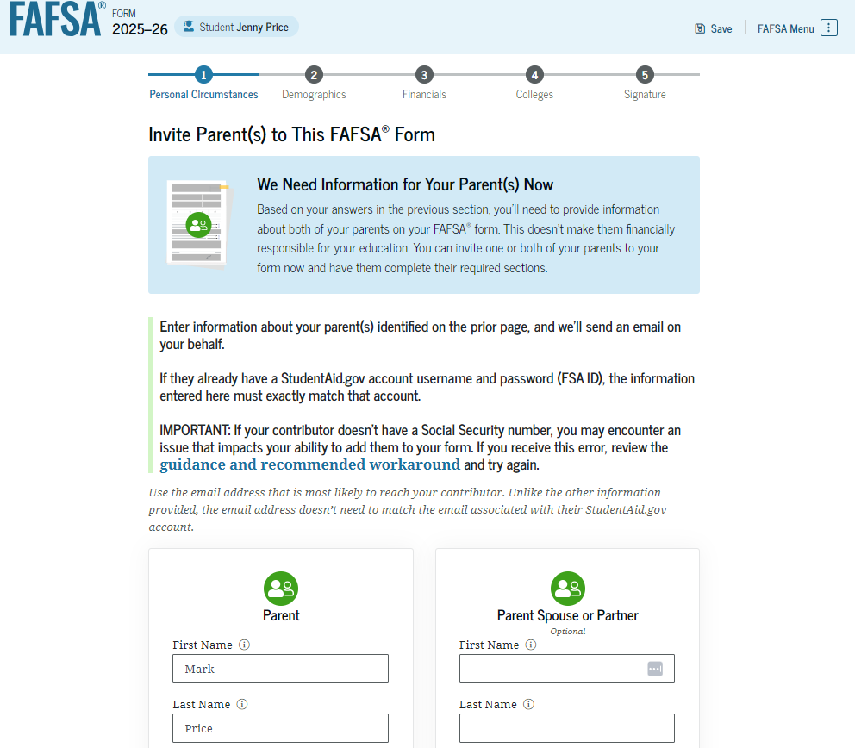
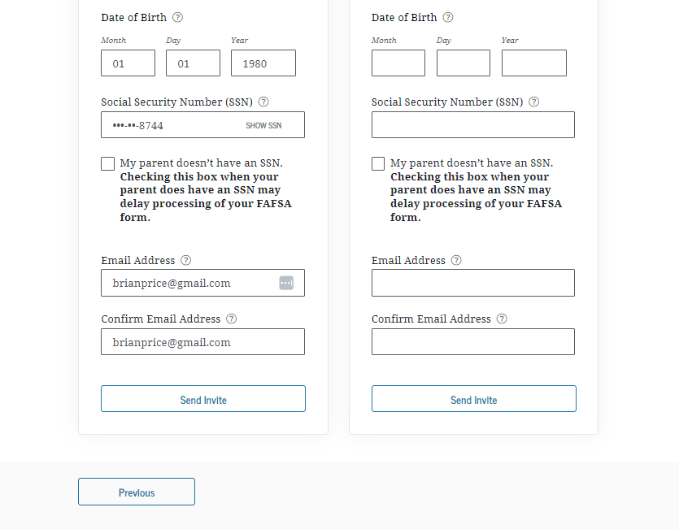
Dependent Student Invites Parents to FAFSA® Form
The student is asked to enter personal information about their parents in order to send them an invite to their FAFSA® form. In this scenario, the student invites one parent.

Slide 27
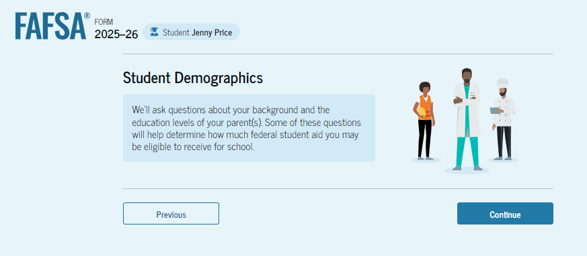
Introduction: Dependent Student Demographics
This is the first page within the "Student Demographics" section. It provides an overview of the section.

Slide 28
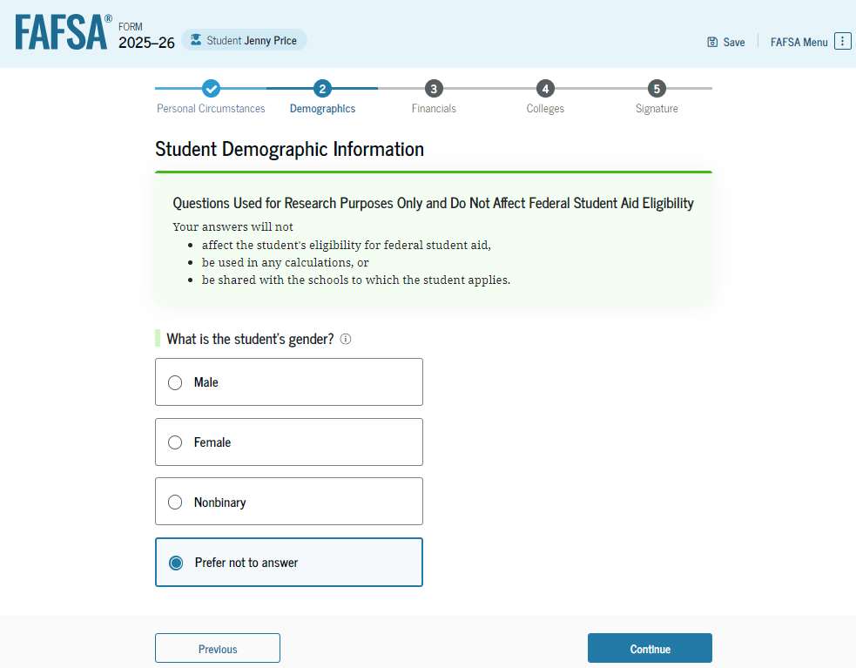
Dependent Student Demographic Information
The student is asked about their gender identity. The student selects “Prefer not to answer.”

Slide 29
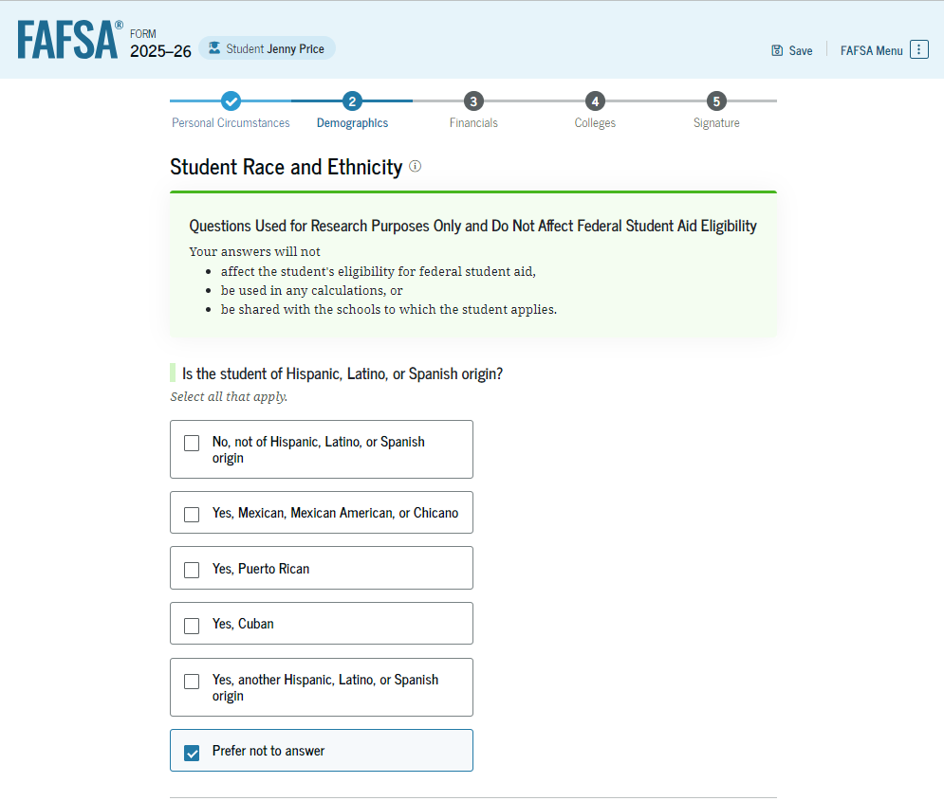
Dependent Student Race and Ethnicity
The student is asked if they are of Hispanic, Latino, or Spanish origin. The student selects the checkboxes that apply to them.

Slide 30
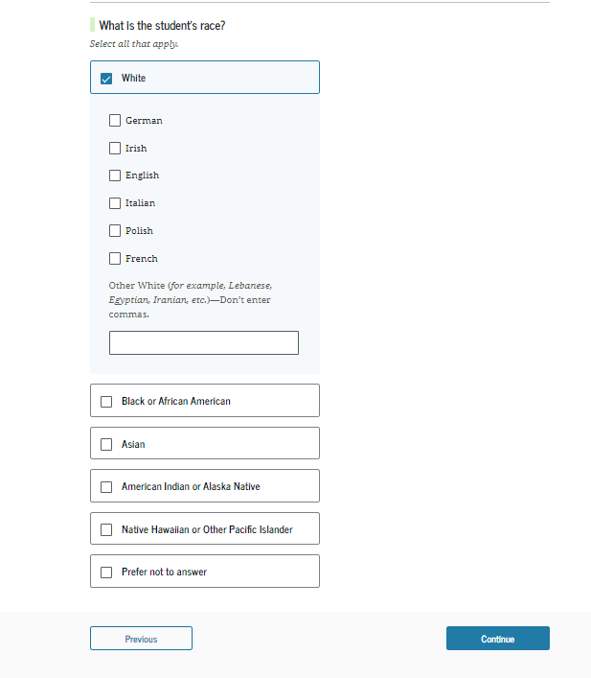
Dependent Student Race and Ethnicity (Continued)
This is a continuation of the student race and ethnicity page. The student is asked to identify their race. The student selects the checkboxes that apply to them.

Slide 31
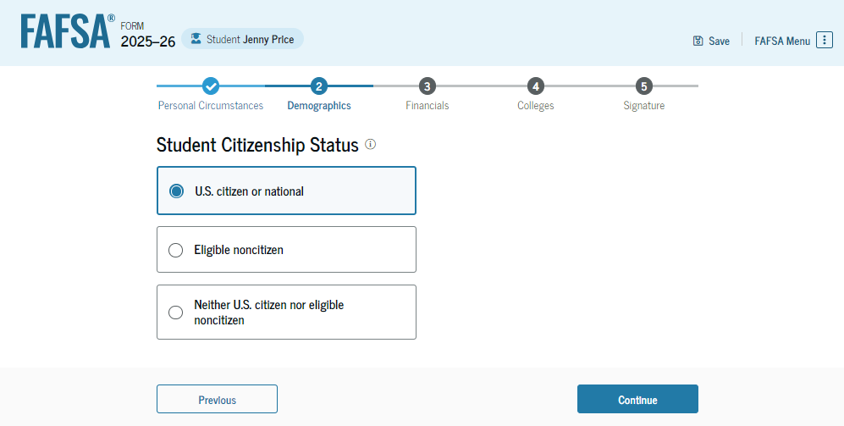
Dependent Student Citizenship Status
The student is asked about their citizenship status. The student selects the "U.S. citizen or national" option.

Slide 32
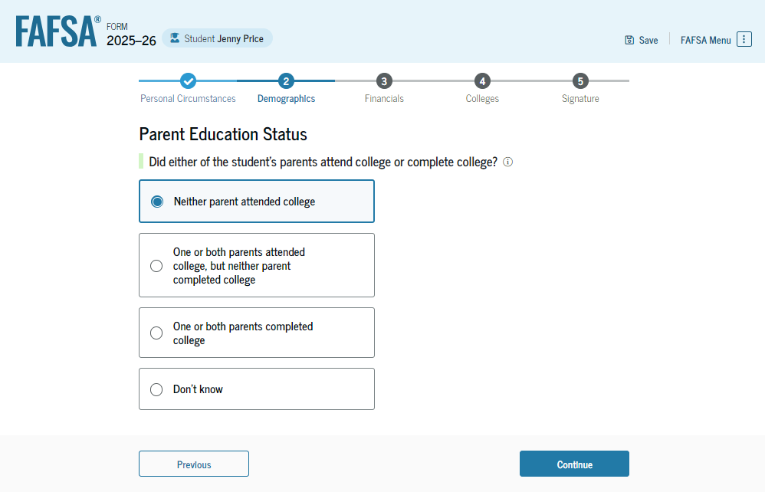
Dependent Student’s Parent Education Status
The student is asked about their parents’ education status. The student selects the "Neither parent attended college" option.

Slide 33
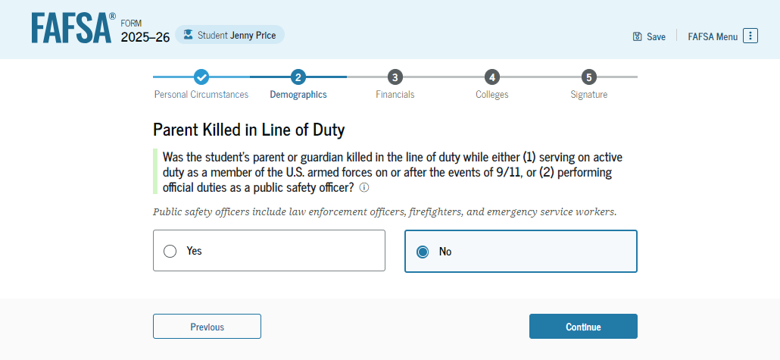
Dependent Student’s Parent Killed in Line of Duty
The student is asked if their parent was killed in the line of duty. The student selects the "No" option.

Slide 34
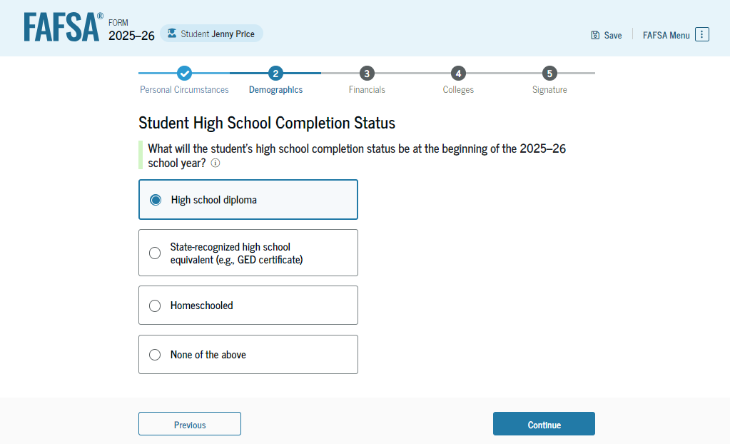
Dependent Student High School Completion Status
The student is asked about what their high school completion status will be when they start the 2025–26 school year. The student selects the "High school diploma" option.

Slide 35
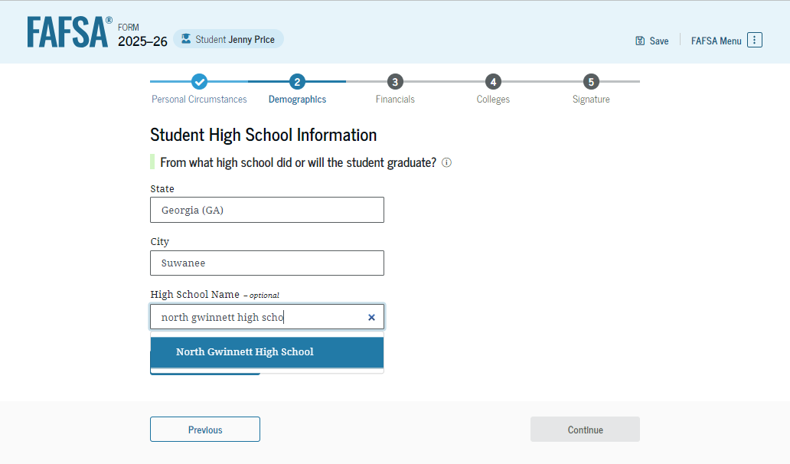
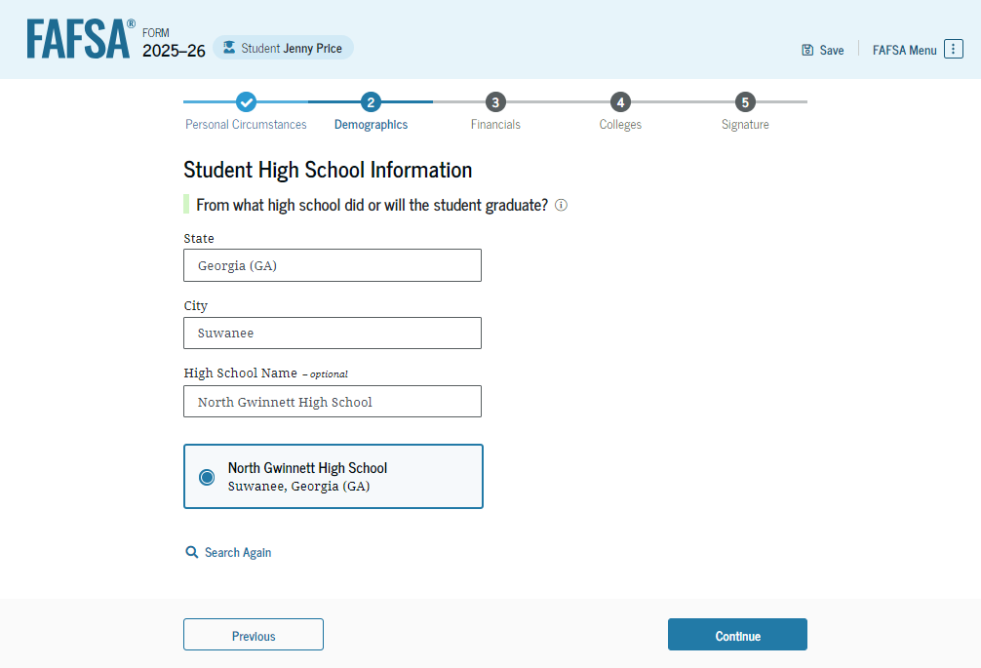
Dependent Student High School Information
The student is asked which high school they did or will graduate from. The student enters their high school’s state and city. After selecting "Search," they select the correct high school from the search results.

Slide 36
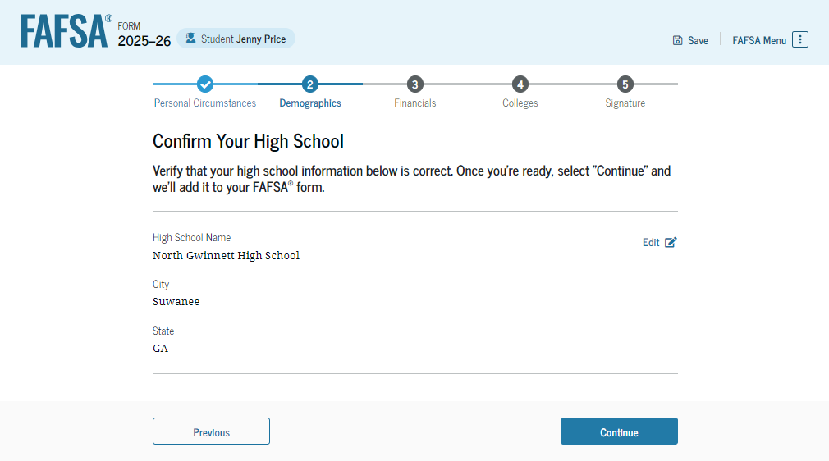
Dependent Student Confirms High School
The student has the option to edit the high school information presented on this page by selecting "Edit," which will return them to the high school information page. The student confirms their high school information and selects "Continue" to proceed to the next section.

Slide 37
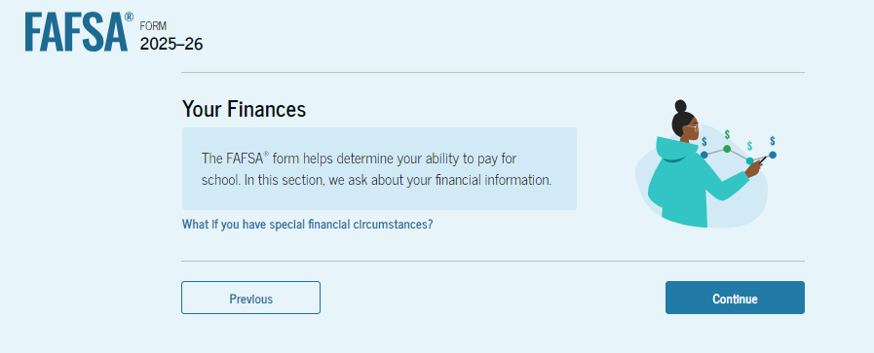
Introduction: Dependent Student Financials
This is the first page within the "Student Financials" section. It provides an overview of the section. The student can select the hyperlink if they want to learn about special financial circumstances.

Slide 38
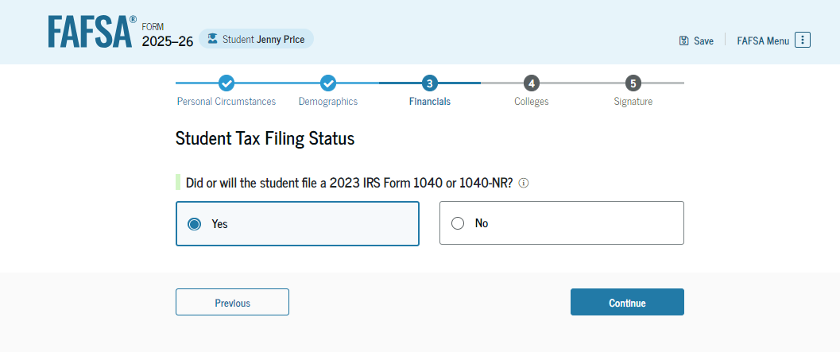
Dependent Student Tax Filing Status
The student is asked about their tax filing status. The student selects "Yes" to "Did or will the student file a 2023 IRS Form 1040 or 1040-NR?"

Slide 39
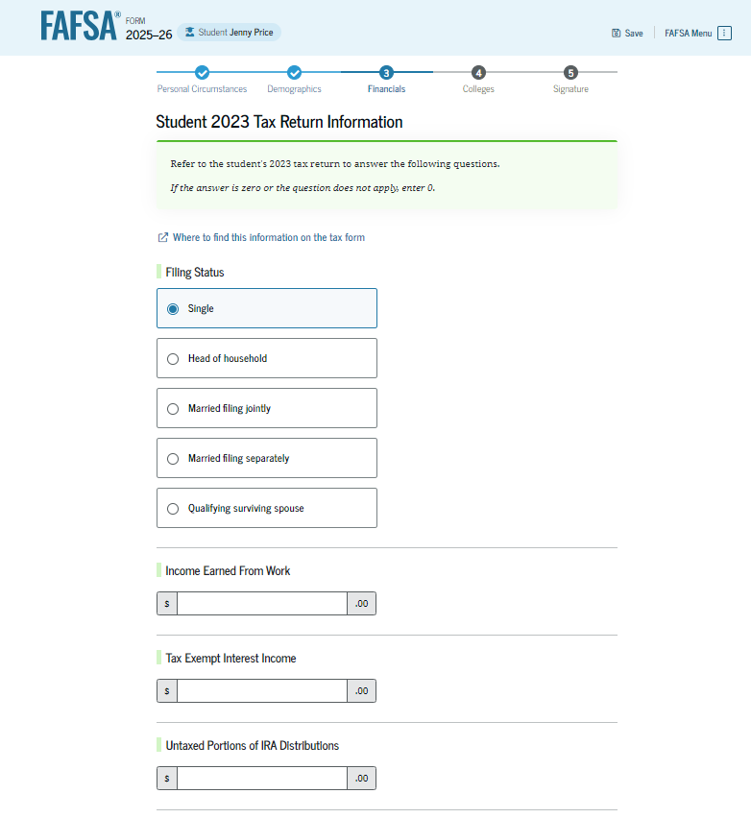
Dependent Student Tax Return Information
The student is asked about their 2023 tax return. The student selects "Single" as their filing status.

Slide 40
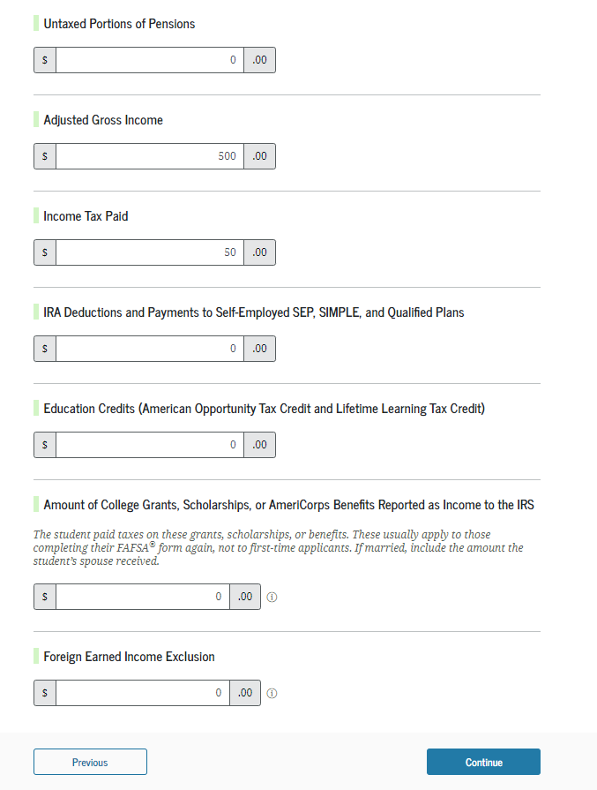
Dependent Student Tax Return Information (Continued)
The student is asked about their taxes, income, and other financial information. The student enters dollar amounts in the responses.

Slide 41
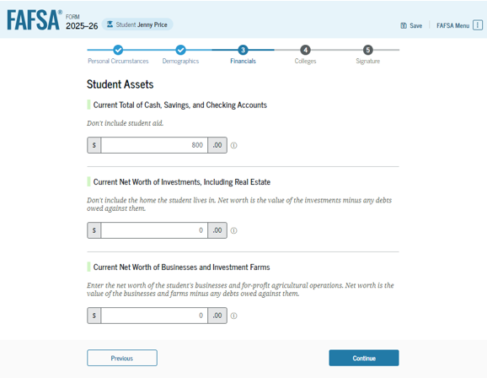
Dependent Student Assets
The student is asked about their assets. The student enters a response in each entry field.

Slide 42
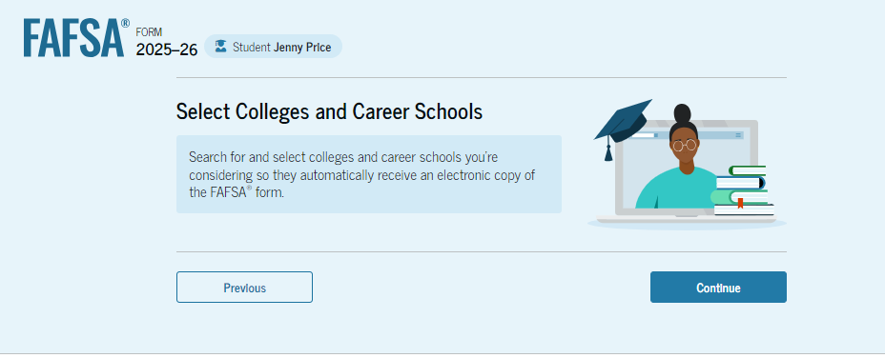
Introduction: Dependent Student Select Colleges
This is the first page in the "Select Colleges and Career Schools" section, which is the final part of the FAFSA® form’s student section to require information. It provides an overview of the section.

Slide 43
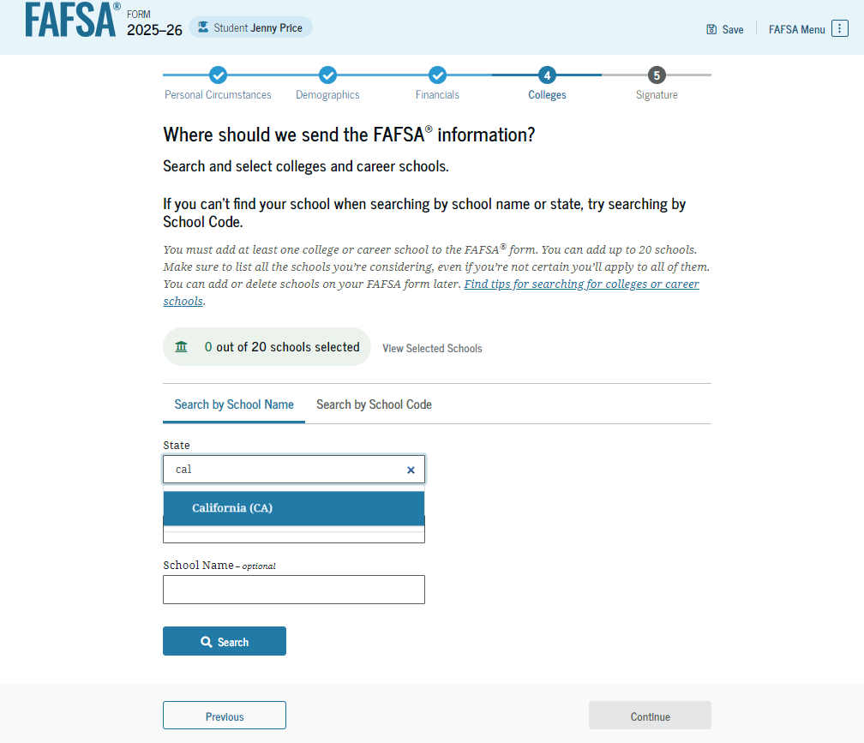
Dependent Student College Search
The student is asked to search for the colleges and/or career schools they would like to receive their FAFSA® information. The student searches for a school by entering a state, city, and/or school name and selecting "Search." If the student can’t find a school searching by school name or state, they can search by school code. The student must add at least one college or career school to continue.

Slide 44
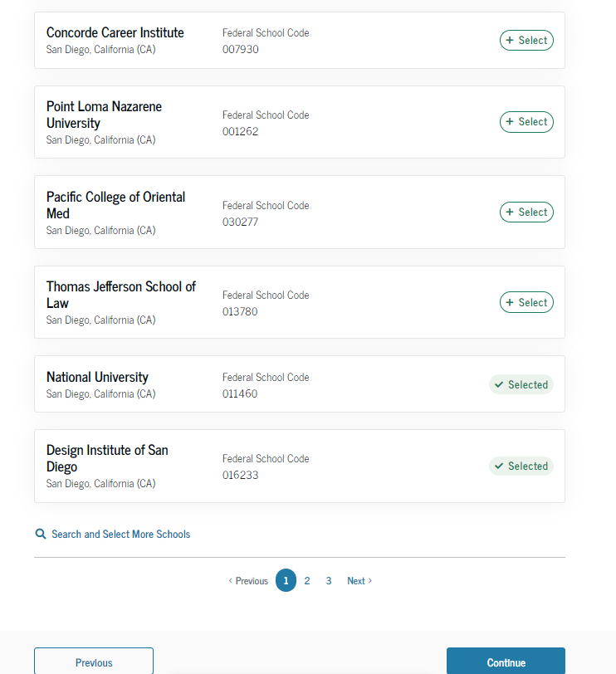
Dependent Student College Search (Continued 1 of 2)
After entering a school’s state, city, and/or school name and selecting "Search," the student selects the correct school(s) from the search results. Students can send their FAFSA® information to a maximum of 20 schools.

Slide 45
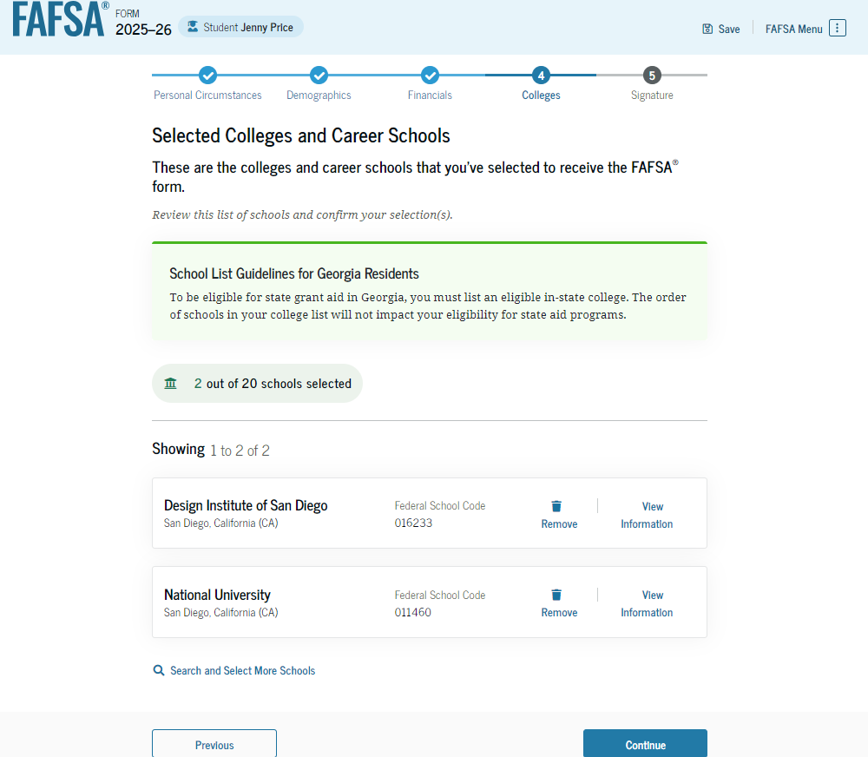
Dependent Student College Search (Continued 2 of 2)
After the student selects the correct school(s) from the search results, they can review the school(s) they chose before continuing.

Slide 46
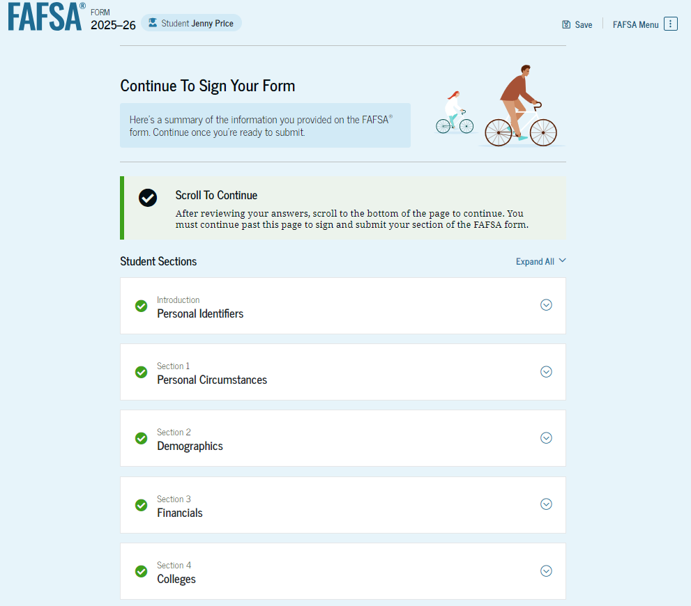
Dependent Student Review Page
The review page displays the responses that the student has provided in the FAFSA® form. The student can view all their responses by selecting "Expand All" or expand each section individually. To edit a response, the student can select the question’s hyperlink to be taken to the corresponding page.

Slide 47
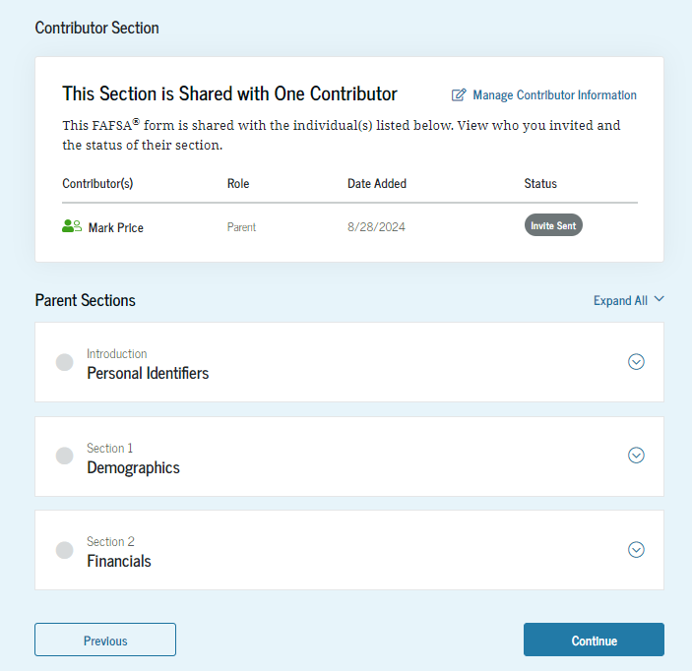
Dependent Student Review Page (Continued)
This is a continuation of the student review page. Since the student invited their parent to their form, they see the parent contributor section and the status of their parent’s invite.

Slide 48
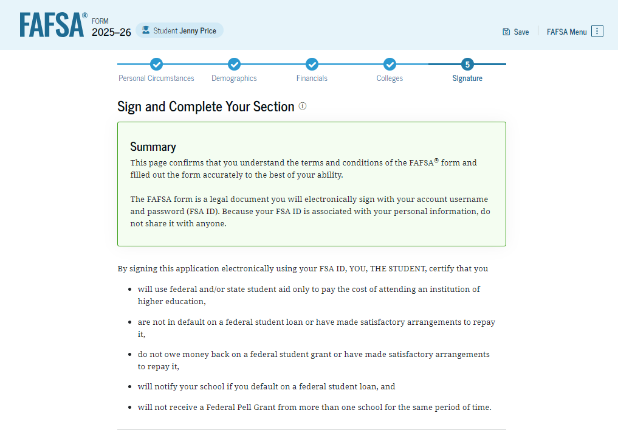
Dependent Student Signature
On this page, the student reviews the terms and conditions of the FAFSA® form and what they’ll agree to if they sign the form.

Slide 49
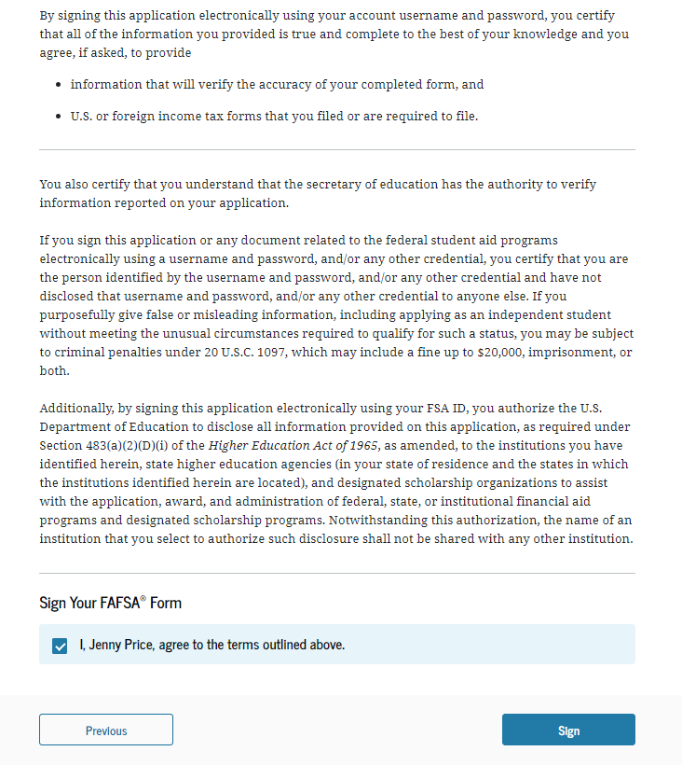
Dependent Student Signature (Continued)
This is a continuation of the student signature page. After agreeing to the terms and conditions of the FAFSA® form and signing, the student is able to submit their section of the FAFSA form. Since parent information has not been provided, the FAFSA form is not considered complete and can’t be processed yet.

Slide 50
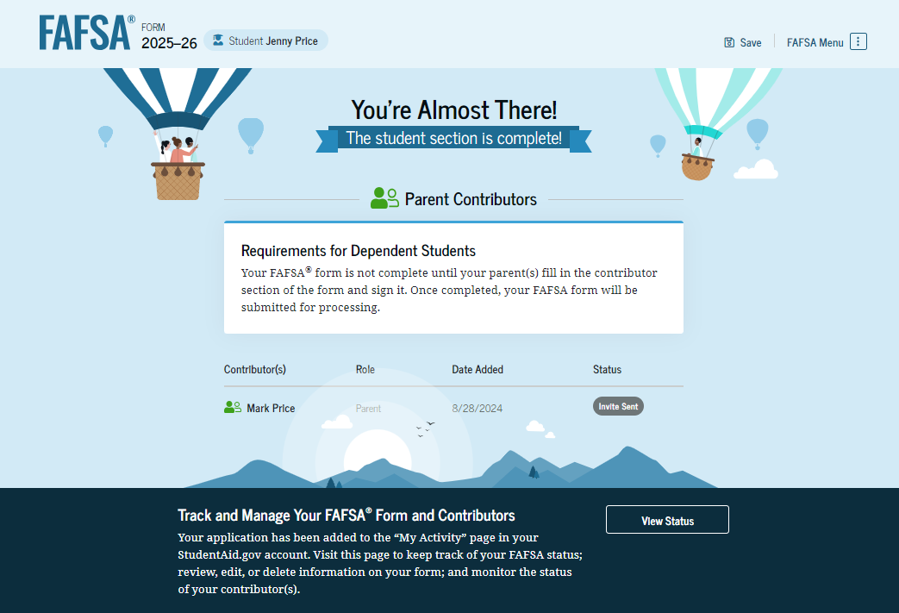
Dependent Student Section Complete
Upon signing the student section, the student is presented “The student section is complete!” page. The student is reminded that their FAFSA® form is not completed and can’t be submitted until the parent completes the contributor section of the form and signs it. This page also displays next steps the student can take, including tracking and managing their form.

Slide 51
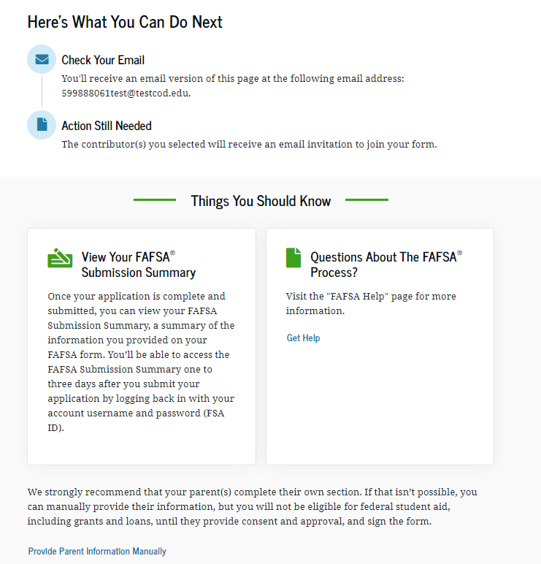
Dependent Student Section Complete (Continued)
This is a continuation of the student section complete page. This page displays information for the student about next steps, including checking their email and a reminder that their FAFSA® form is not completed and can’t be submitted until the parent completes the contributor section of the form and signs it. Next, in this scenario, the student’s invited parent will enter the FAFSA form and complete the parent section.

Slide 52
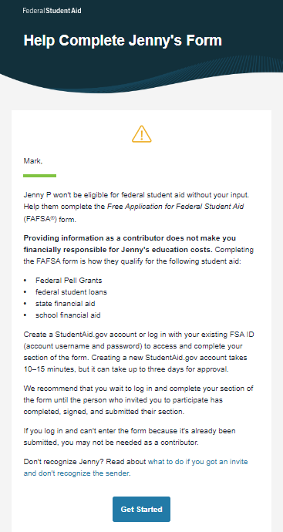
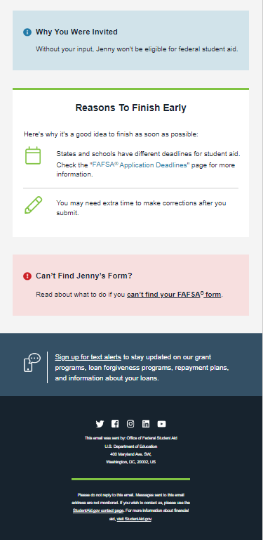
Dependent Student’s Parent Email
This is NOT a view within StudentAid.gov or the FAFSA® form. This view demonstrates a parent opening the FAFSA invitation from their email. The parent selects "Get Started" and is taken to StudentAid.gov.

Slide 53

Dependent Student’s Parent Log In
The parent is taken from their email to the "Log In" page to enter their credentials. To access the FAFSA® form, all users are required to have an FSA ID (StudentAid.gov account username and password). If the parent doesn't have an FSA ID, they can select "Create an Account."

Slide 54

Parent Status Center – My Activity
After successfully logging in, the parent is taken to their "My Activity" section. The parent sees an invitation to be a contributor on the student’s FAFSA® form.

Slide 55

Parent Status Center – My Activity (Continued)
When the parent selects "Accept Invitation," a pop-up window appears to remind the parent that their personal information is needed to fill out the student’s FAFSA® form. The parent selects "Continue" to agree to sharing their information and enters the FAFSA form.

Slide 56

Dependent Student’s Parent Onboarding (1 of 4)
When the parent enters a 2025–26 FAFSA® form for the first time, they are taken through the FAFSA onboarding process. The first onboarding page provides an introduction of the FAFSA form and an accompanying video.

Slide 57

Dependent Student’s Parent Onboarding (2 of 4)
The second FAFSA® onboarding page provides information about contributors that may be required to participate in the student’s FAFSA form, including an accompanying video that explains contributors, and information on how the parent will invite them. Documents that may be needed to fill out the form are also included on this page.

Slide 58

Dependent Student’s Parent Onboarding (3 of 4)
The third FAFSA® onboarding page provides information about what the parent can expect when completing the student’s FAFSA form. This includes information about consent and approval, a time estimate to complete the form, and that they can save the form and return later if needed, along with an accompanying video.

Slide 59

Dependent Student’s Parent Onboarding (4 of 4)
The last onboarding page provides information about what to expect once the FAFSA® form is completed, submitted, and processed. On this page, the parent selects "Start FAFSA Form" to begin the parent section.

Slide 60

Dependent Student’s Parent Identity Information
This is the first page within the parent section. The parent can verify that their personal information is correct. To update any of the personal information, the parent must access their Account Settings on StudentAid.gov.

Slide 61

Dependent Student’s Parent Identity Information
(Continued)
This is a continuation of the first page within the parent section. The parent can verify their mailing address on this part of the page. To update this information, the parent must access their Account Settings on StudentAid.gov.

Slide 62

Dependent Student’s Parent Provides
Consent and Approval
This page informs the parent about consent, approval, and the use of their federal tax information. By providing consent and approval, the parent’s federal tax information is transferred directly into the FAFSA® form from the IRS to help complete the "Parent Financials" section.

Slide 63


Dependent Student’s Parent Provides Consent and Approval (Continued)
This is a continuation of the consent and approval page. Frequently asked questions about consent and approval are also provided that the parent can expand and collapse. The parent selects "Approve" to provide consent and approval, and they are taken to the next page.

Slide 64

Dependent Student’s Parent Imports IRS Information
This page imports the parent’s federal tax information by directly transferring it into the FAFSA® form from the IRS to help complete the “Parent Financials" section.

Slide 65

Dependent Student’s Parent Imports IRS Information (Continued)
This page displays the results from the IRS import for the parent. For this scenario, the parent is contributing to a new FAFSA® form and there is no federal tax information available from the IRS.

Slide 66

Introduction: Dependent Student’s Parent Demographics
This is the first page in the "Parent Demographics" section. It provides an overview of the section.

Slide 67

Dependent Student’s Parent Current Marital Status
The parent is asked about their current marital status. They select the "Married (not separated)" option.

Slide 68

Dependent Student’s Parent State of Legal Residence
The parent is asked about their state of legal residence. The parent selects the state from a drop-down box and provides the month and year when they became a legal resident.

Slide 69

Introduction: Dependent Student’s Parent Finances
This is the first page within the "Parent Financials" section. It provides an overview of the section.

Slide 70

Dependent Student’s Parent Federal Benefits Received
This page asks the parent if they or anyone in their family has received federal benefits. The parent selects "None of these apply."

Slide 71

Dependent Student’s Parent Tax Filing Status
This page asks the parent about their tax filing status. The parent selects "Yes" to "Did or will the parent file a 2023 IRS Form 1040 or 1040-NR?" and “Yes” to “Did or will the parent file a 2023 joint tax return with their current spouse?”

Slide 72

Dependent Student’s Parent Family Size
This page displays the family size for the student. The parent has the option to enter the number of children or other dependents who live with the parent and will receive more than half of their support from the parent between July 1, 2025, and June 30, 2026.

Slide 73

Dependent Student’s Parent Number in College
This page asks the parent how many people in the family will be in college between July 1, 2025, and June 30, 2026. The parent enters a response into the entry field.

Slide 74


Dependent Student’s Parent Tax Return Information
The parent is asked questions about their 2023 tax return. The parent enters a response in each entry field.

Slide 75

Dependent Student’s Parent Assets
The parent is asked about their assets. The parent enters a response in each entry field.

Slide 76

Dependent Student’s Other Parent Information
The parent is asked to provide information about their spouse or partner. In this example, the other parent does not need to contribute to the student’s FAFSA® form because the parents filed taxes jointly. After providing the other parent’s information, all required parent information will be complete.

Slide 77

Dependent Student’s Parent Review Page
The review page displays the responses that the parent has provided in the FAFSA® form. The parent can only view responses within the parent section of the student’s FAFSA form. The parent can view all their responses by selecting "Expand All" or expand each section individually. To edit a response, the parent can select the question’s hyperlink to be taken to the corresponding page.

Slide 78

Dependent Student’s Parent Signature
On this page, the parent acknowledges the terms and conditions of the FAFSA® form and signs their section. Since all required sections are complete, the parent can both sign and submit the student’s FAFSA form.

Slide 79

Dependent Student FAFSA® Confirmation
Upon submitting the student’s FAFSA® form, the parent is presented an abbreviated confirmation page. This page displays information about tracking the student’s FAFSA form and next steps. The student will receive an email with the full, detailed confirmation. With the student and parent sections completed and signed, the FAFSA form is now considered complete and submitted for processing.

Slide 80
Parent Starts and Submits a FAFSA® Form Without Student Consent or Signature

Slide 81

Parent FAFSA® Landing Page
This is the main FAFSA® form landing page. On this page, students and parents are directed to "Start New Form" or “Edit Existing Forms." For this section of the presentation, the parent is beginning a new application on behalf of their child.

Slide 82
Parent Log In
If the parent selects "Start New Form" from the FAFSA® landing page and they are not logged in to StudentAid.gov, they are taken to the "Log In" page to enter their credentials. To access the FAFSA form, all parents are required to have an FSA ID (account username and password). If the parent doesn't have an FSA ID, they can select "Create an Account."​

Slide 83

Parent Roles
After logging in, the parent selects the applicable role to fill out the FAFSA® form: "Parent."

Slide 84

Parent’s Student Information
The parent is asked to provide the student’s information. Since the student has not started a FAFSA® form yet, they will receive an email notifying them that a FAFSA form was started on their behalf. The student can then enter the form to provide consent, sign the form, and make any needed corrections.

Slide 85

Parent Onboarding (1 of 4)
When the parent starts the 2025–26 FAFSA® form for the first time, they are taken through the FAFSA onboarding process. The first onboarding page provides an introduction of the FAFSA form and an accompanying video.

Slide 86

Parent Onboarding (2 of 4)
The second FAFSA® onboarding page provides information about contributors that may be required to participate in the student’s FAFSA form, including an accompanying video that explains contributors, and information on how the parent will invite them. Documents that may be needed to fill out the form are also included on this page within a drop-down menu and may include tax returns; record of child support received; current balances of cash, savings, and checking accounts; and net worth of investments, businesses, and farms.

Slide 87

Parent Onboarding (3 of 4)
The third FAFSA® onboarding page provides information about what the parent can expect when completing the student’s FAFSA form. This includes information about consent and approval, a time estimate to complete the form, and that they can save the form and return later if needed, along with an accompanying video.

Slide 88

Parent Onboarding (4 of 4)
The final FAFSA® onboarding page provides information about what to expect once the FAFSA form is completed, submitted, and processed. On this page, the parent can select "Start FAFSA Form" to begin.

Slide 89

Parent’s Student Identity Information
After starting the FAFSA® form, the parent sees the first page within the parent section. The parent can verify that the student’s personal information is correct. To update any of the personal information, the student must access their Account Settings on StudentAid.gov. The parent will not be able to update the student’s information on this page.

Slide 90

Parent’s Student Identity Information (Continued)
This is a continuation of the "Parent Identity Information" page. The parent can verify that the student’s personal information is correct.

Slide 91

Parent’s Student State of Legal Residence
The parent is asked about the student’s state of legal residence. The parent selects the state from a drop-down box and provides the month and year when the student became a legal resident.

Slide 92

Introduction: Parent’s Student Personal Circumstances
This is the first page within the "Student Personal Circumstances" section. It provides an overview of the section.

Slide 93

Parent’s Student Marital Status
The parent is asked about the student’s marital status. The parent selects the "Single (never married)" option.

Slide 94

Parent’s Student College or Career School Plans
The parent is asked about the student’s college grade level for the 2025–26 school year and if the student will have their first bachelor’s degree. The parent selects that the student will be a "First year (freshman)" and that they will not have their first bachelor’s degree.

Slide 95

Parent’s Student Personal Circumstances
The parent is asked if any of the listed personal circumstances apply to the student. The parent selects "None of these apply."

Slide 96

Parent’s Student Homelessness
The parent is asked if the student was unaccompanied and either homeless or at risk of being homeless. The parent selects "No."

Slide 97

Parent’s Student Unusual Circumstances
The parent is asked if unusual circumstances prevent the student from contacting their parent(s). The parent selects "No."

Slide 98

Parent’s Student Dependency Status: Dependent Student
Based on the answers provided by the parent, the student is considered a dependent student. The parent is asked if they want a financial aid administrator to determine the student’s eligibility for a Direct Unsubsidized Loan only. This is an option if they are unwilling to provide their information. The parent selects "No."

Slide 99

Parent Identity Information
This is the first page within the parent section. The parent can verify that their personal information is correct. To update any of the personal information, the parent must access their Account Settings on StudentAid.gov.

Slide 100

Parent Identity Information (Continued)
This is a continuation of the first page within the parent section. The parent can verify their mailing address on this part of the page. To update this information, the parent must access their Account Settings on StudentAid.gov.

Slide 101
Parent Provides Consent and Approval
This page informs the parent about consent, approval, and the use of their federal tax information. By providing consent and approval, the parent’s federal tax information is transferred directly into the FAFSA® form from the IRS to help complete the "Parent Financials" section.

Slide 102
Parent Provides Consent and Approval (Continued)
This is a continuation of the consent and approval page. Frequently asked questions about consent and approval are also provided that the parent can expand and collapse. The parent selects "Approve" to provide consent and approval, and they are taken to the next page.

Slide 103
Parent Imports IRS Information
This page imports the parent’s federal tax information by directly transferring it into the FAFSA® form from the IRS to help complete the “Parent Financials" section.

Slide 104
Parent Imports IRS Information (Continued)
This page displays the results from the IRS import for the parent. For this scenario, the parent is starting a new FAFSA and there is no federal tax information available from the IRS.

Slide 105

Introduction: Parent Demographics
This is the first page in the "Parent Demographics" section. It provides an overview of the section.

Slide 106

Parent Current Marital Status
The parent is asked about their current marital status. They select the "Single (never married)" option.

Slide 107

Parent State of Legal Residence
The parent is asked about their state of legal residence. The parent selects the state from a drop-down box and provides the month and year when they became a legal resident.

Slide 108

Introduction: Parent Financials
This is the first page within the "Parent Financials" section. It provides an overview of the section.

Slide 109

Parent Federal Benefits Received
This page asks the parent if they or anyone in their family has received federal benefits. The parent selects "None of these apply."

Slide 110

Parent Tax Filing Status
This page asks the parent about their tax filing status. The parent selects "Yes" to "Did or will the parent file a 2023 IRS Form 1040 or 1040-NR?"

Slide 111

Parent Family Size
This page displays the family size for the parent. The parent has the option to enter the number of children or other dependents who live with the parent and will receive more than half of their support from the parent between July 1, 2025, and June 30, 2026.

Slide 112

Parent Number in College
This page asks the parent how many people in the family will be in college between July 1, 2025, and June 30, 2026. The parent enters a response into the entry field.

Slide 113

Parent Tax Return Information
The parent is asked questions about their 2023 tax return. They enter a response in each entry field.

Slide 114

Parent Assets
The parent is asked about their assets. The parent enters a response in each entry field.

Slide 115

Parent Review Page
The review page displays the responses that the parent has provided in the previous student and parent sections of the student’s FAFSA® form. The parent can view all their responses by selecting "Expand All" or expand each section individually. To edit a response, they can select the question’s hyperlink to be taken to the corresponding page.

Slide 116

Parent Signature
On this page, the parent acknowledges the terms and conditions of the FAFSA® form and signs their section. After agreeing and signing, the parent is able to submit their section of the FAFSA form. Since the student section is incomplete, the FAFSA form is not considered complete and can’t be processed yet. ​

Slide 117

Parent Section Complete
Upon signing the parent section, the parent is presented “The parent section is complete!” page. This page displays information for the parent about next steps, including tracking the student’s FAFSA® form. The parent is reminded that the student’s form is not complete and can’t be processed until the student section is complete.

Slide 118

Parent Section Complete (Continued)
This is a continuation of the parent section complete page. This page displays information for the parent about next steps, including checking their email. The parent is told that they can manually provide their information, but the student will not be eligible for federal student aid until the student provides consent, approval, and their signature. Next, in this scenario, the parent selects "Provide Student Information Manually" and enters the student section.

Slide 119

Introduction: Parent’s Student Demographics
This is the first page within the "Student Demographics" section. It provides an overview of the section.

Slide 120

Parent’s Student Demographic Information
The parent is asked about the student’s gender identity. The parent selects “Prefer not to answer.”

Slide 121


Parent’s Student Race and Ethnicity
The parent is asked if the student is of Hispanic, Latino, or Spanish origin. They are also asked about the student’s race. The parent selects checkboxes to answer both questions.

Slide 122

Parent’s Student Citizenship Status
The parent is asked about the student’s citizenship status. The parent selects the "U.S. citizen or national" option.

Slide 123

Parent Education Status
The parent is asked about their education status. They select the "Neither parent attended college" option.

Slide 124

Parent Killed in Line of Duty
The parent is asked if the student's parent or guardian was killed in the line of duty. The parent selects the "No" option.

Slide 125

Parent’s Student High School Completion Status
The parent is asked what the student’s high school completion status will be when they start the 2025–26 school year. The parent selects the "High school diploma" option.

Slide 126


Parent’s Student High School Information
The parent is asked which high school the student did or will graduate from. The parent enters the student’s high school’s state and city. After selecting "Search," they select the correct high school from the search results. ​

Slide 127

Parent Confirms High School
The parent is asked to confirm the high school information. By selecting "Edit," they will return to the high school information page. The parent verifies the student’s high school information and selects "Continue" to proceed to the next section.

Slide 128

Introduction: Parent’s Student Financials
This is the first page within the "Student Financials" section. It provides an overview of the section.

Slide 129

Parent’s Student Tax Filing Status
This page asks the parent about the student’s tax filing status. The parent selects "Yes" to "Did or will the student file a 2023 IRS Form 1040 or 1040-NR?"

Slide 130

Parent’s Student Tax Return Information
Since the student has not provided consent and approval for their federal tax information to be transferred directly into the FAFSA® form, the parent is asked to manually enter the student’s 2023 tax return information. The parent selects their tax filing status and enters a response in each entry field. ​

Slide 131
Parent’s Student Tax Return Information (Continued)
This is a continuation of the student’s 2023 tax information page. The parent enters a response in each entry field.

Slide 132

Parent’s Student Assets
The parent is asked about the student’s assets. The parent enters a response in each entry field.

Slide 133

Introduction: Parent Select Colleges
This is the first page in the "Select Colleges and Career Schools" section, which is the final part of the FAFSA® form’s student section to require information. It provides an overview of the section.

Slide 134


Parent College Search
The parent is asked to search for the colleges, career schools, and/or trade schools they would like to receive the student’s FAFSA® information. The parent searches for a school by entering a state, city, and/or school name. After selecting "Search," they select the correct school(s) from the search results. Parents can send the student’s FAFSA information to a maximum of 20 schools. The parent is required to add at least one college or career school.

Slide 135


Parent Selected Colleges
The parent can view which colleges, career schools, and/or trade schools they have selected for the student. If the parent has not selected 20 schools, they have the option to search and select more schools. When the parent selects "Continue," they will have completed entering the required student information for the student section and can proceed to the review page.

Slide 136

Parent’s Student Review Page
The review page displays the responses that the parent has provided in the FAFSA® form on behalf of the student. The parent can view all the responses by selecting "Expand All" or expanding each section individually. To edit a response, the parent can select the question’s hyperlink and will be taken to the corresponding page. The parent cannot provide a signature for the student.

Slide 137

Parent’s Student Review Page (Continued)
This is a continuation of the review page displays the responses that the parent has provided in the FAFSA® form in the parent sections. The parent can view all the responses by selecting "Expand All" or expanding each section individually. To edit a response, the parent can select the question’s hyperlink and will be taken to the corresponding page.

Slide 138

Parent Receives Student Missing Consent Message
The parent is presented the missing student consent and approval message after hitting the "Submit" button on the review page. This message explains that because the student’s consent and approval and signature are missing, the student is currently ineligible for federal student aid, including grants and loans.

Slide 139

Parent’s Student Section Complete
The parent is presented the student section complete page after the parent hits "Submit" on the message. This page displays information for the parent about next steps, including tracking the student’s FAFSA® form. Because the student’s consent and approval and signature are missing, the student is currently ineligible for federal student aid, including grants and loans. The student must enter their form, provide their consent and approval and signature, and submit the student section for their FAFSA form to be processed.

Slide 140
Independent Student Invites
Student Spouse

Slide 141
Married Student FAFSA® Form Landing Page
This is the main FAFSA® form landing page. On this page, students are directed to "Start New Form" or "Edit Existing Forms." For this section of the presentation, the student is beginning a new application.

Slide 142
Married Student Log In
If the student selects "Start New Form" from the FAFSA® landing page and they are not logged in to StudentAid.gov, they are taken to the "Log In" page to enter their credentials. To access the FAFSA form, all students are required to have an FSA ID (account username and password). If the student doesn't have an FSA ID, they can select "Create an Account."

Slide 143

Married Student Roles
After logging in, the student selects the applicable role to fill out the FAFSA® form: "Student."

Slide 144

Married Student Onboarding (1 of 4)
When the student starts the 2025–26 FAFSA® form for the first time, they are taken through the FAFSA onboarding process. The first onboarding page provides an introduction of the FAFSA form and an accompanying video.

Slide 145

Married Student Onboarding (2 of 4)
The second FAFSA® onboarding page provides information about contributors that may be required to participate in the student’s FAFSA form, including an accompanying video that explains contributors, and information on how the student will invite them. Documents that may be needed to fill out the form are also included on this page within a drop-down menu and may include tax returns; record of child support received; current balances of cash, savings, and checking accounts; and net worth of investments, businesses, and farms.

Slide 146

Married Student Onboarding (3 of 4)
The third FAFSA® onboarding page provides information about what the student can expect when completing their FAFSA form. This includes information about consent and approval, an estimated time to complete the form, and that they can save the form and return later if needed, with an accompanying video.

Slide 147

Married Student Onboarding (4 of 4)
The last FAFSA® onboarding page provides information about what to expect once the FAFSA form is completed, submitted, and processed. On this page, the student can select "Start FAFSA Form" to begin.

Slide 148

Married Student Identity Information
This is the first page within the student section. The student can verify that their personal information is correct. To update any of the personal information, the student must access their Account Settings on StudentAid.gov.

Slide 149

Married Student Identity Information (Continued)
This is a continuation of the first page within the student section. The student can verify their mailing address on this part of the page. To update this information, the student must access their Account Settings on StudentAid.gov.

Slide 150

Married Student State of Legal Residence
The student is asked about their state of legal residence. The student selects the state from a drop-down box and provides the month and year when they became a legal resident.

Slide 151

Married Student Provides Consent and Approval
This page informs the student about consent, approval, and the use of their federal tax information. By providing consent and approval, the student’s federal tax information is transferred directly from the IRS into the FAFSA® form to help complete the "Student Financials" section.

Slide 152


Married Student Provides Consent and Approval (Continued)
This is a continuation of the consent and approval page. Frequently asked questions about consent and approval are also provided. The student selects "Approve" to provide consent and approval, and they are taken to the next page.

Slide 153

Married Student Imports IRS Information
This page imports the student’s federal tax information by directly transferring it into the FAFSA® form from the IRS to help complete the "Student Financials" section.

Slide 154

Married Student Imports IRS Information (Continued)
This page displays the results from the IRS import for the student. For this scenario, the student is starting a new FAFSA and there is no federal tax information available from the IRS.

Slide 155

Introduction: Married Student Personal Circumstances
This is the first page within the "Student Personal Circumstances" section. It provides an overview of the section.

Slide 156

Married Student Marital Status
The student is asked about their marital status. The student selects the "Married (not separated)" option.

Slide 157

Married Student College or Career School Plans
The student is asked about their college grade level for the 2025–26 school year and if they will have their first bachelor’s degree. The student selects “Master’s or doctorate program (such as, M.A., MBA, M.D., J.D., Ph.D., Ed.D., etc.)" and that they will have their first bachelor’s degree. Because they have answered "Yes," the student is asked if they will be pursuing an initial teaching certification. The student selects "No."

Slide 158

Married Student Personal Circumstances
The student is asked if any of the listed personal circumstances apply to them. The student selects "None of these apply.”

Slide 159

Married Student Homelessness
The student is asked if they were unaccompanied and either homeless or at risk of being homeless. The student selects "No."

Slide 160

Married Student Dependency Status: Independent Student
Based on the answers provided by the student, they are considered an independent student. The student is not required to provide information about their parents due to this status.

Slide 161

Introduction: Married Student Demographics
This is the first page within the "Student Demographics" section. It provides an overview of the section.

Slide 162

Married Student Demographic Information
The student is asked about their gender identity. The student selects their response from the options listed.

Slide 163


Married Student Race and Ethnicity
The student is asked if they are of Hispanic, Latino, or Spanish origin. They are also asked about their race. The student selects checkboxes to answer both questions.

Slide 164

Married Student Citizenship Status
The student is asked about their citizenship status. The student selects the "U.S. citizen or national" option.

Slide 165

Married Student’s Parent Education Status
The student is asked about their parents’ education status. The student selects the "Neither parent attended college" option.

Slide 166

Married Student’s Parent Killed in Line of Duty
Since the student is under the age of 33, they are asked if their parent was killed in the line of duty. The student selects the "No" option.

Slide 167

Married Student High School Completion Status
The student is asked about what their high school completion status will be when they start the 2025–26 school year. The student selects the "High school diploma" option.

Slide 168


Married Student High School Information
The student is asked which high school they did or will graduate from. The student enters their high school’s state and city. After selecting "Search," they select the correct high school from the search results.

Slide 169

Married Student Confirms High School
The student has the option to edit the high school information presented on this page by selecting "Edit," which will return them to the high school information page. The student confirms their high school information and selects "Continue" to proceed to the next section.

Slide 170

Introduction: Married Student Financials
This is the first page within the "Student Financials" section. It provides an overview of the section.

Slide 171

Married Student Federal Benefits Received
This page asks the student if they or anyone in their family has received federal benefits. The student selects "None of these apply."

Slide 172

Married Student Tax Filing Status
This page asks the student about their tax filing status. The student selects "Yes" to "Did or will the student file a 2023 IRS Form 1040 or 1040-NR?" and "No" to "Did or will the student file a 2023 joint tax return with their current spouse?"

Slide 173

Married Student Family Size
This page displays the family size for the student. The student has the option to enter the number of children or other dependents who live with the student and will receive more than half of their support from the student between July 1, 2025, and June 30, 2026.

Slide 174

Married Student Number in College
This page asks the student how many people in the family will be in college between July 1, 2025, and June 30, 2026. The student enters a response into the entry field.

Slide 175


Married Student Tax Return Information
The student is asked questions about their 2023 tax return. The student enters a response in each entry field.

Slide 176

Married Student Assets
The student is asked about their and their spouse’s assets and the amount of child support received. The student enters a response in each entry field.

Slide 177


Invite Spouse to Your FAFSA® Form
Based on their marital status and the information provided by the student, the student is required to invite their spouse to their FAFSA® form to complete the required student spouse sections. The student enters the personal information about their spouse in order to send them an invite to their form.

Slide 178

Introduction: Married Student Select Colleges
This is the first page in the "Select Colleges and Career Schools" section, which is the final part of the FAFSA® form’s student section to require information. It provides an overview of the section.

Slide 179


Married Student College Search
The student is asked to search for the colleges and/or career schools they would like to receive their FAFSA® information. The student searches for a school by entering a state, city, and/or school name. After selecting "Search," they select the correct school(s) from the search results. Students can send their FAFSA information to a maximum of 20 schools.

Slide 180

Married Student Selected Colleges
The student can view which colleges and/or career schools they have selected. If the student has not selected 20 schools, they have the option to search and select more schools, and, in some states, they have the option to reorder the list of selected schools. When the student selects "Continue," they will have completed entering the required student information for their section and can proceed to review and sign their form.

Slide 181


Married Student Review Page
The review page displays the responses that the student has provided in the FAFSA® form. The student can view all their responses by selecting "Expand All" or expand each section individually. To edit a response, the student can select the question’s hyperlink and will be taken to the corresponding page. Additionally, since the student invited their spouse into the form, they see the spouse contributor section and the status of their spouse’s invite.

Slide 182

Married Student Signature
On this page, the student reviews the terms and conditions for signing their FAFSA® form. They agree to a list of statements that they certify before providing their signature.

Slide 183

Married Student Signature (Continued)
This is a continuation of the student signature page. After agreeing to the terms and conditions of the FAFSA® form and signing, the student is able to submit their section of the FAFSA form. Since the student spouse information has not been provided, the FAFSA form is not considered complete and can’t be processed yet.

Slide 184

Married Student Section Complete
Upon signing the student section, the student is presented the student section complete page. This page displays information for the student about next steps, including tracking their FAFSA® form. The student is reminded that their form is not completed and can’t be submitted until their spouse completes the contributor section of the form and signs it.

Slide 185

Married Student Section Complete (Continued)
This is a continuation of the student section complete page. This page displays information for the student about next steps, including checking their email and a reminder that their FAFSA® form is not completed and can’t be submitted until the student spouse completes the contributor section of the form and signs it. Next, in this scenario, the student’s invited spouse will enter the FAFSA form and complete the spouse section.

Slide 186


Student Spouse Email
This is NOT a view within StudentAid.gov or the FAFSA® form. This view demonstrates a student spouse opening the FAFSA invitation from their email. The student spouse selects "Get Started" and is taken to StudentAid.gov.

Slide 187
Student Spouse Log In
The student spouse is taken from their email to the "Log In" page to enter their log-in credentials. To access the FAFSA® form, all users are required to have an FSA ID (StudentAid.gov account username and password). If the student spouse doesn't have an FSA ID, they can select "Create an Account."

Slide 188

Student Spouse Status Center – My Activity
After successfully logging in, the student spouse is taken to their "My Activity" section. The student spouse sees an invitation to be a contributor on the student’s FAFSA® form.

Slide 189

Student Spouse Status Center – My Activity (Continued)
When the student spouse selects "Accept Invitation," a pop-up window appears to remind the student spouse that their personal information is needed to fill out the student’s FAFSA® form. The student spouse selects "Continue" to agree to sharing their information and enters the FAFSA form.

Slide 190

Student Spouse Contributing to the FAFSA® Form
This page provides information about being a contributor on a FAFSA® form.

Slide 191

Student Spouse Identity Information
This is the first page within the student spouse section. The student spouse can verify that their personal information is correct. To update any of the personal information, the student spouse must access their Account Settings on StudentAid.gov.

Slide 192

Student Spouse Provides Consent and Approval
This page informs the student spouse about consent, approval, and the use of their federal tax information. By providing consent and approval, the student spouse’s federal tax information is transferred directly from the IRS into the FAFSA® form to help complete the "Student Spouse Financials" section.

Slide 193

Student Spouse Provides Consent and Approval (Continued)
This is a continuation of the consent and approval page. Frequently asked questions about consent and approval are also provided. The student spouse selects "Provide Approval" to provide consent and approval, and they are taken to the next page.

Slide 194

Student Spouse Imports IRS Information
This page imports the student spouse’s federal tax information by directly transferring it into the FAFSA® form from the IRS to help complete the "Student Spouse Financials" section.

Slide 195
Student Spouse Imports IRS Information (Continued)
This page displays the results from the IRS import for the student spouse. For this scenario, the student spouse is contributing to a new FAFSA® and there is no federal tax information available from the IRS.

Slide 196

Introduction: Student Spouse Financials
This is the first page within the "Student Spouse Financials" section. It provides an overview of the section.

Slide 197

Student Spouse Tax Filing Status
This page asks the student spouse about their tax filing status. The student spouse selects "Yes" to "Did or will the student’s spouse file a 2023 IRS Form 1040 or 1040-NR?"

Slide 198


Student Spouse Tax Return Information
The student spouse is asked questions about their 2023 tax return. The student spouse enters a response in each entry field.

Slide 199

Student Spouse Review Page
The review page displays the responses that the student spouse has provided in the FAFSA® form. In this scenario, the student spouse can only view responses within the student spouse section of the student’s FAFSA form. The student spouse can view all their responses by selecting "Expand All" or expand each section individually. To edit a response, the student spouse can select the question’s hyperlink to be taken to the corresponding page.

Slide 200

Student Spouse Signature
On this page, the student spouse acknowledges the terms and conditions of the FAFSA® form and signs their section. Since all required sections are complete, the student spouse can both sign and submit the student’s FAFSA form.

Slide 201

Student Spouse Confirmation
Upon submitting the student’s FAFSA® form, the student spouse is presented an abbreviated confirmation page. This page displays information about tracking the student’s FAFSA form and next steps. The student will receive an email with the full, detailed confirmation. With the student and student spouse sections completed and signed, the FAFSA form is now considered complete and submitted for processing.

Slide 202
Independent Student Who Is Single and a Non-Tax Filer

Slide 203
Independent Student FAFSA® Form Landing Page
This is the main FAFSA® form landing page. On this page, students are directed to "Start New Form" or “Edit Existing Form." For this section of the presentation, the student is beginning a new application.

Slide 204
Independent Student Log In
If the student selects "Start New Form" from the FAFSA® landing page and they are not logged in to StudentAid.gov, they are taken to the "Log In" page to enter their credentials. To access the FAFSA form, all students are required to have an FSA ID (StudentAid.gov account username and password). If the student doesn't have an FSA ID, they can select "Create an Account."

Slide 205

Independent Student Roles
After logging in, the student selects the applicable role to fill out the FAFSA® form: "Student."

Slide 206

Independent Student Onboarding (1 of 4)
When the student starts the 2025–26 FAFSA® form for the first time, they are taken through the FAFSA onboarding process. The first onboarding page provides an introduction of the FAFSA form and an accompanying video.

Slide 207

Independent Student Onboarding (2 of 4)
The second FAFSA® onboarding page provides information about contributors that may be required to participate in the student’s FAFSA form, including an accompanying video that explains contributors, and information on how the student can invite them. Documents that may be needed to fill out the form are also included on this page.

Slide 208

Independent Student Onboarding (3 of 4)
The third FAFSA® onboarding page provides information about what the student can expect when completing their FAFSA form. This includes information about consent and approval, a time estimate to complete the form, and that they can save the form and return later if needed, along with an accompanying video.

Slide 209

Independent Student Onboarding (4 of 4)
The last FAFSA® onboarding page provides information about what to expect once the FAFSA form is completed, submitted, and processed. On this page, the student can select "Start FAFSA Form" to begin.

Slide 210

Independent Student Identity Information
This is the first page within the student section. The student can verify that their personal information is correct. To update any of the personal information, the student must access their Account Settings on StudentAid.gov.

Slide 211

Independent Student Identity Information (Continued)
This is a continuation of the first page within the student section. The student can verify their mailing address on this part of the page. To update this information, the student must access their Account Settings on StudentAid.gov.

Slide 212

Independent Student State Of Legal Residence
The student is asked about their state of legal residence. The student selects the state from a drop-down box and provides the month and year when they became a legal resident.

Slide 213


Independent Student Provides Consent and Approval
This page informs the student about consent, approval, and the use of their federal tax information. By providing consent and approval, the student’s federal tax information is transferred directly from the IRS into the FAFSA® form to help complete the "Student Financials" section.

Slide 214


Independent Student Provides Consent and Approval (Continued)
This is a continuation of the consent and approval page. Frequently asked questions about consent and approval are also provided that the student can expand and collapse. The student selects "Approve" to provide consent and approval, and they are taken to the next page.

Slide 215

Independent Student Imports IRS Information
This page imports the student’s federal tax information by directly transferring it into the FAFSA® form from the IRS to help complete the "Student Financials" section.

Slide 216

Independent Student Imports IRS Information (Continued)
This page displays the results from the IRS import for the student. For this scenario, the student is starting a new FAFSA and there is no federal tax information available from the IRS.

Slide 217

Independent Student Personal Circumstances
This is the first page within the "Student Personal Circumstances" section. It provides an overview of the section.

Slide 218

Independent Student Marital Status
The student is asked about their marital status. The student selects the "Single (Never Married)" option.

Slide 219

Independent Student College or Career School Plans
The student is asked about their college grade level for the 2025–26 school year and if they will have their first bachelor’s degree. The student selects that they will be a "First Year (freshman)" and that they will not have their first bachelor’s degree.

Slide 220

Independent Student Personal Circumstances (Continued)
The student is asked if any of the listed personal circumstances apply to them. The student selects "None of these apply.”

Slide 221

Independent Student Homelessness
The student is asked if they are unaccompanied and either homeless or at risk of being homeless. The student selects "No."

Slide 222

Student Dependency Status: Independent Student
Because the student’s date of birth is before Jan. 1, 2002, they are considered an independent student.

Slide 223

Introduction: Independent Student Demographics
This is the first page within the "Student Demographics" section. It provides an overview of the section.

Slide 224

Independent Student Demographic Information
The student is asked about their gender identity. The student selects “Prefer not to answer.”

Slide 225

Independent Student Race and Ethnicity
The student is asked if they are of Hispanic, Latino, or Spanish origin. The student selects checkbox that applies to them.

Slide 226

Independent Student Race and Ethnicity (Continued)
A continuation of the student race and ethnicity page. The student is asked to identify their race. The student selects the checkboxes that apply to them. After making their selection, a second drop-down appears, and the student selects the checkboxes that apply to them.

Slide 227

Independent Student Citizenship Status
The student is asked about their citizenship status. The student selects the "U.S. citizen or national" option.

Slide 228

Independent Student’s Parent Education Status
The student is asked about their parents’ education status. The student selects the "Neither parent attended college" option.

Slide 229

Independent Student’s Parent Killed in Line of Duty
Since the student is under the age of 33, they are asked if their parent was killed in the line of duty. The student selects the "No" option.

Slide 230

Independent High School Completion Status
The student is asked about what their high school completion status will be when they start the 2025–26 school year. The student selects the "High school diploma" option.

Slide 231


Independent Student High School Information
The student is asked which high school they did or will graduate from. The student enters their high school’s state and city. After selecting "Search," they select the correct high school from the search results.

Slide 232

Independent Student Confirms High School
The student has the option to edit the high school information presented on this page by selecting "Edit," which will return them to the high school information page. The student confirms their high school information and selects "Continue" to proceed to the next section.

Slide 233

Introduction: Independent Student Financials
This is the first page within the "Student Financials" section. It provides an overview of the section. The student can select the hyperlink if they want to learn about special financial circumstances.

Slide 234

Independent Student Federal Benefits
The student is asked if they or anyone in their family has received federal benefits. The student selects “None of these apply.”

Slide 235

Independent Student Tax Filing Status
This page asks the student about their tax filing status. The student selects "No" to "Did or will the student file a 2023 IRS Form 1040 or 1040-NR?" Because of this selection, the student is asked if they earned income in a foreign country, were employed by an international organization but not required to report income on any tax return, or filed a tax return with Puerto Rico or another U.S. territory. The student selects "No."

Slide 236

Independent Student Number in College
This page asks the student how many people in the family will be in college between July 1, 2025, and June 30, 2026. The student enters a response into the entry field.

Slide 237

Introduction: Independent Student Select Colleges
This is the first page in the "Select Colleges" section, which is the final part of the FAFSA® form’s student section to require information. It provides an overview of the section.

Slide 238


Independent Student College Search
The student is asked to search for the colleges and/or career schools they would like to receive their FAFSA® information. The student searches for a school by entering a state, city, and/or school name. After selecting "Search," they select the correct school(s) from the search results. Students can select to send their FAFSA information to a maximum of 20 schools. The student is required to add at least one college or career school.

Slide 239

Independent Student Selected Colleges
The student can view which college(s) and/or career school(s) they have selected. If the student has not selected 20 schools, they have the option to search and select more schools. When the student selects "Continue," they will have completed entering the required student information for their section and can proceed to review and sign their form.

Slide 240

Independent Student Review Page
The review page displays the responses that the student has provided in the FAFSA® form. The student can view all the responses by selecting "Expand All" or expand each section individually. To edit a response, the student can select the question’s hyperlink and they will be taken to the corresponding page.

Slide 241

Independent Student Signature
On this page, the student reviews the terms and conditions of the FAFSA® form and what they’ll agree to if they sign the form.

Slide 242

Independent Student Signature (Continued)
This is a continuation of the student signature page. After agreeing to the terms and conditions of the FAFSA® form and signing, the student is able to submit their section of the FAFSA form. Since all required sections are complete, the student can both sign and submit the FAFSA form.

Slide 243

Independent Student Confirmation Page
The student is presented the confirmation page. This page displays information for the student about their completion date and data release number for their FAFSA® form, along with an estimate for their Student Aid Index. The student is informed they may be eligible for a Federal Pell Grant, which may be a result of their negative SAI.

Slide 244

Independent Student Confirmation Page (Continued)
This is a continuation of the student section complete page. This page displays information for the student about next steps, including checking their email, tracking their FAFSA® form, and receiving communications from their school.

Slide 245
FAFSA Submission Summary

Slide 246

FAFSA Submission Summary Landing Page
The student receives a FAFSA Submission Summary for their processed FAFSA® form and any subsequent corrections that they submit. The FAFSA Submission Summary is broken into four tabs: “Eligibility Overview,” “FAFSA Form Answers,” “School Information,” and “Next Steps.” At the top, the student will see when their form was received and processed. They also have the option to print their FAFSA Submission Summary to keep for their records.

Slide 247

Eligibility Overview
On the "Eligibility Overview" tab, the student sees information about what federal student aid they may be eligible for, such as a Federal Pell Grant and Federal Direct Loans. Any amounts of financial aid that display on this tab are estimates and are not guaranteed. Final determination of the student’s financial aid eligibility is provided by their school’s financial aid office.

Slide 248

Eligibility Overview (Continued)
This is a continuation of the "Eligibility Overview" tab of the FAFSA Submission Summary. Final determination of the student’s financial aid eligibility is provided by their school’s financial aid office. They are also able to view their Student Aid Index.

Slide 249

FAFSA Form Answers
On the "FAFSA Form Answers" tab, the student sees the answers that they provided on their FAFSA® form. If any of the provided answers are incorrect, the student can choose make a correction.

Slide 250

FAFSA Form Answers (Continued)
This is a continuation of the "FAFSA Form Answers" tab, where the student sees the answers that they provided on their FAFSA® form.

Slide 251


FAFSA Form Answers Contributors
This is a continuation of the "FAFSA Form Answers" tab. If applicable, student sees the answers their contributor(s) provided on their FAFSA® form.

Slide 252

School Information
On the "School Information" tab, the student sees information about the college(s) and/or career school(s) that they selected to send their FAFSA® information. The student can compare the graduation rate, retention rate, transfer rate, default rate, median debt upon completion, and average annual cost of their selected schools.

Slide 253

Next Steps
On the "Next Steps" tab, the student sees comments that pertain to their FAFSA® form. Some comments may require the student to make a correction or send additional documentation to their school. Other comments may be informational and do not require any further action from the student.

Slide 254

More Resources
Lastly, along the right side of their FAFSA Submission Summary, the student can access additional resources, including visiting “My Aid” or College Scorecard.

Slide 255
Dependent Student and Direct Unsubsidized Loan

Slide 256

Dependency Status: Dependent Student
If the parents of a dependent student are unwilling to provide their information but the student doesn’t have an unusual circumstance, the student can choose to have their school determine their eligibility for a Direct Unsubsidized Loan only.
Note: Selecting “Yes” here makes the student ineligible for other types of federal student aid, such as Federal Pell Grants, Federal Work-Study, or Direct Subsidized Loans.

Slide 257

Dependent Student Selects Direct Unsubsidized Loan Only
If the student selects "Yes" to have their school determine their eligibility for a Direct Unsubsidized Loan only and then selects "Continue," a pop-up window appears warning the student that they will not be eligible for most federal student aid.

Slide 258
Unaccompanied Homeless Youth

Slide 259

Student Homelessness
The student is asked if they were unaccompanied and either homeless or at risk of being homeless. The student selects "Yes." Next, the student is asked who determined that they are homeless or at risk of being homeless. They select "None of these apply."

Slide 260

Impact of Unaccompanied Homeless Youth Status
Based on the answers provided by the student, they are not required to provide parent information on the FAFSA® form. The student is able to sign and submit the FAFSA form, but they will need to contact the financial aid office at their school about their circumstances. The school will be required to make
a determination of the student’s unaccompanied homeless youth status based on a written statement from the student or a documented interview with the student. Until the student’s circumstances are verified, the U.S. Department of Education's office of Federal Student Aid will only provide the student an estimate of their federal student aid eligibility.

Slide 261
Provisionally Independent Student

Slide 262

Student Unusual Circumstances
The student is asked if unusual circumstances prevent them from contacting their parent(s). The student selects "Yes."

Slide 263
Impact of Provisionally Independent Status
Based on the answers provided by the student, they are considered a provisionally independent student and are not required to provide parent information. The student is able to sign and submit their FAFSA® form, but they will need to contact their school to see what supporting documentation they need to submit. A financial aid administrator at the school will review and make a determination regarding a dependency override. Until the student’s circumstances are verified, the U.S. Department of Education's office of Federal Student Aid will only provide the student an estimate of their federal student aid eligibility.

Slide 264
Student Adds Schools to FAFSA® Form

Slide 265
Add Schools Log In
To access an existing FAFSA® form, the student is required to have an FSA ID (StudentAid.gov account username and password).

Slide 266

Add Schools Dashboard
On the account Dashboard, the student can see their most recent 2025–26 FAFSA® activity under the "My Activity" section. In this scenario, the student has a processed 2025–26 FAFSA form. To see further information about this application, the student selects the application and is taken to the "Details" page.

Slide 267

Add Schools Details
On the "Details" page, the student sees information related to their processed FAFSA® form, such as when it was started and processed, their FAFSA Submission Summary, and additional resources. Within the "Actions" menu, the student can select "Add or Remove Schools.” Selecting this option will start a voluntary correction to update their selected schools.

Slide 268

Add Schools Details (Continued)
Farther down the "Details" page, the student sees their invited contributor(s), selected school(s) and FAFSA® submission history. In this scenario, the student selects "Add or Remove Schools" within the "Actions" menu to update their selected schools.

Slide 269

Add Schools Onboarding
When the student starts a 2025–26 FAFSA® correction, they are taken through the FAFSA correction onboarding process. A correction should only be submitted if critical information was missing, incorrect information was provided, the student needs to update their selected school(s), and/or a correction was requested by a financial aid administrator. The student selects "Add or Remove Schools" to begin their correction.

Slide 270

Add Schools Selected Colleges and Career Schools
The student can view which college(s), career school(s), or trade school(s) they selected in their processed application. If the student has not selected 20 schools, they have the option to search and select more schools, and, in some states, they have the option to reorder the list of selected schools. In this scenario, the student wants to remove their selected school and add new ones. The student selects "Remove" for the listed school.

Slide 271

Add Schools Selected Colleges and Career Schools (Continued)
After removing the school, the student selects "Search and Select More Schools" and is taken to the college search page.

Slide 272

Add Schools College Search
The student is asked to search for the colleges, career schools, or trade schools they would like to receive their FAFSA® information. The student searches for a school by entering a state and a city and/or school name.

Slide 273

Add Schools College Search (Continued)
After entering a school’s state and city and/or school name and selecting "Search," the student selects the correct school(s) from the search results. Students can send their FAFSA® information to a maximum of 20 schools.

Slide 274

Add Schools Selected Colleges
The student can view which new college(s), career school(s), and/or trade school(s) they have selected. When they select "Continue," they will have completed updating the "Select Colleges and Career Schools" section and can proceed to the review changes page.

Slide 275

Add Schools Review Changes Page
The review page displays the school(s) that the student has added and/or removed. If the student needs to make additional updates to the rest of their form, they can select "Make More Changes." The student is ready to submit their correction and selects "Continue."

Slide 276

Sign and Submit Changes to the FAFSA Form
On this page, the student reviews the terms and conditions of the FAFSA® form and what they’ll agree to if they sign the form.

Slide 277

Sign and Submit Changes to the FAFSA Form (Continued)
This is a continuation of the student signature page. After agreeing to the terms and conditions of the FAFSA® form and signing, the student is able to resubmit their section of the FAFSA form.

Slide 278

Add Schools Confirmation
After the student has submitted their correction, they are presented the confirmation page. This page displays information for the student about next steps, including tracking their FAFSA® correction.

Slide 279
Student Submits a FAFSA® Correction to Homeless Determination

Slide 280
Homeless Determination Correction Log In
To access an existing FAFSA® form, the student is required to log in using their FSA ID (StudentAid.gov account username and password).

Slide 281

Homeless Determination Correction Dashboard
On the account Dashboard, the student can see their most recent 2025–26 FAFSA® activity under the "My Activity" section. In this scenario, the student has a processed 2025–26 FAFSA form. To see further information about this application, the student selects the application and is taken to the "Details" page.

Slide 282

Homeless Determination Correction Details
On the "Details" page, the student sees information related to their processed FAFSA® form, such as when it was started and processed, their FAFSA Submission Summary, and additional resources. Within the "Actions" menu, the student can select "Make Corrections" to start a voluntary correction.

Slide 283

Homeless Determination Correction Onboarding
When the student starts a 2025–26 FAFSA® correction, they are taken through the FAFSA correction onboarding process. A correction should only be submitted if critical information was missing, incorrect information was provided, the student needs to update their selected school(s), and/or a correction was requested by a financial aid administrator.

Slide 284

Homeless Determination Correction Select Correction Type
A student can choose to update their selected schools, answers to questions on their FAFSA® form, and/or contributor contact information (if a contributor was invited to their form). In this scenario, the student selects "Update Answers to Questions on Your FAFSA® Form."

Slide 285

Homeless Determination Correction Select Correction Type (Continued)
When the student selects to update their answers to questions on their FAFSA® form, a message displays explaining when a correction should and shouldn’t be submitted. In this scenario, the student’s school instructed them to update their response to the homeless determination question. The student selects "Continue."

Slide 286

Homeless Determination Correction Section Summary
The "Section Summary" page displays all the sections belonging to the logged-in user, which in this case is the student. The student selects to enter "Section 1: Personal Circumstances" where the homeless determination question was answered. This takes the student to the first question within the "Student Personal Circumstances" section.

Slide 287

Homeless Determination Correction Marital Status
The Student Marital Status page is the first question within the "Student Personal Circumstances" section. The student is asked about their current marital status. They maintain their response of "Single (never married)."

Slide 288

Homeless Determination Correction College or Career School Plans
The student is asked about their college grade level for the 2025–26 school year and if they will have their first bachelor’s degree. The student maintains their response of being a "First year (freshman)" and not having their first bachelor’s degree.

Slide 289

Homeless Determination Correction Personal Circumstances
The student is asked if any of the listed personal circumstances apply to them. The student maintains their response "None of these apply."

Slide 290

Homeless Determination Correction Other Circumstances
The student is asked if they were homeless or at risk of being homeless. The student updates their response to "Yes." After selecting this response, the student is asked who made the homelessness determination. They select "Financial aid administrator."

Slide 291

Homeless Determination Correction Other
Circumstances (Continued)
When the student selects "Continue," a message displays informing the student that their dependency status has changed. They select "Continue."

Slide 292

Homeless Determination Correction Dependency Status
Based on the updated answers provided by the student, they are considered an independent student. The student selects "Continue" and enters the "Student Demographics" section.

Slide 293

Homeless Determination Correction Demographic Information
The student is asked about their gender identity. They maintain their response of "Female." Since the student has finished their correction, they select "Skip to end of form" to proceed with submitting their correction.

Slide 294

Homeless Determination Correction Review Changes Page
The review page displays the responses that the student has updated in their FAFSA® form. The student can view all their updated answers and previous answers by selecting "Expand All" or by expanding each section individually. To edit a response, the student can select the "Edit" button beside each question and will be taken to the corresponding page. If the student needs to make additional updates, they can select "Make More Changes." The student is ready to submit their correction and selects "Continue."

Slide 295


Homeless Determination Correction Signature
After confirming their changes, the student reviews, signs, and submits the terms and conditions of the FAFSA® form.

Slide 296

Homeless Determination Correction Confirmation
After the student has submitted their correction, they are presented the confirmation page. This page displays information for the student about next steps, including tracking their FAFSA® correction.

Slide 297
Student Manages FAFSA® Contributors

Slide 298
Manage FAFSA® Contributors Log In
To access an existing FAFSA® form, the student is required to have an FSA ID (StudentAid.gov account username and password).

Slide 299

Manage FAFSA® Contributors Dashboard
On the account Dashboard, the student can see their most recent 2025–26 FAFSA® activity under the "My Activity" section. In this scenario, the student has a processed 2025–26 FAFSA form. To see further information about this application, the student selects the application and is taken to the "Details" page.

Slide 300

Manage FAFSA® Contributors Details
On the "Details" page, the student sees information related to their processed FAFSA® form, such as when it was started and processed, their FAFSA Submission Summary, and additional resources. If a required contributor was invited to the student’s form, the student can select "Edit Contributor Information" within the "Actions" menu. This option allows the student to resend the invitation if they provided the wrong information for their contributor.

Slide 301


Manage FAFSA® Contributors Details (Continued)
Farther down the "Details" page, the student sees their invited contributor(s), selected school(s), and FAFSA® submission history. In this scenario, the student selects "Edit Contributor Information" within the "Actions" menu to resend an invitation to their spouse.

Slide 302

Manage FAFSA® Contributors Onboarding
When the student starts a 2025–26 FAFSA® correction, they are taken through the FAFSA correction onboarding process. A correction should only be submitted if critical information was missing, incorrect information was provided, the student needs to update their selected school(s), and/or a correction was requested by a financial aid administrator.

Slide 303


Manage FAFSA® Contributors Update Contributor
This page displays the invitation(s) that were sent on the processed form. When the student selects "Update Information" on their spouse’s invitation, a message displays informing the student that if they choose to update their spouse’s information, their spouse’s section will be reset on their FAFSA® form and a new invitation will be sent. The student selects "Confirm."

Slide 304

Manage FAFSA® Contributors Update Contributor Details
The student is able to provide information for their new spouse and send a new invitation. As a result, the information provided in the student spouse section will be reset. The new student spouse will have to accept the new invitation, provide consent and approval (if not previously provided), and provide their signature for the student’s FAFSA® form to be processed successfully.

Slide 305

Manage FAFSA® Contributors Update Contributor Details (Continued)
The student provides the remaining information for their new spouse. To confirm the updated information and send the new contributor invite, the student selects "Invite Spouse."

Slide 306

Manage FAFSA® Contributors Invite Sent
This page informs the student that the invite to their new spouse has been sent. The student spouse will receive an email inviting them to enter the FAFSA® form to complete their required sections. The student closes their FAFSA correction by selecting "Exit."

Slide 307

Manage FAFSA® Contributors Correction Details
After updating contributor information and exiting the FAFSA® form, the student returns to the "Details" page. The student sees information related to their FAFSA correction. In this scenario, the student chooses to return to their form and enter the student spouse section. To begin this process, the student selects "Edit Form."

Slide 308

Manage FAFSA® Contributors Section Summary
After selecting "Edit Form," the student reenters their FAFSA® correction. The "Section Summary" page displays all the sections of the student’s FAFSA form.

Slide 309

Manage FAFSA® Contributors Section Summary (Continued)
This is a continuation of the "Section Summary" page. The remaining sections of the student’s FAFSA® form are displayed. In this scenario, the student selects the hyperlink to "Provide Contributor Information."

Slide 310

Manage FAFSA® Contributors Section Summary (Pop-Up) 1
After the student selects "Provide Contributor Information," a message displays informing the student that their contributor will be required to review and sign the changes that the student makes to their contributor’s section(s). The student selects "Confirm Changes."

Slide 311

Manage FAFSA® Contributors Student Spouse Section Summary
After the student confirms that they want to make updates to a contributor section, the "Section Summary" page displays all the sections belonging to the contributor(s), which in this case is the student spouse. The student selects to enter the "Student Spouse Financials" section.

Slide 312

Manage FAFSA® Contributors Section Summary (Pop-Up) 2
When the student selects to enter the "Student Spouse Financials" section on their FAFSA® form, a message displays explaining that the student spouse will need to review and sign the changes made in this section. The student selects "Confirm Changes."

Slide 313

Manage FAFSA® Contributors Student Spouse Identity Information
This is the first page within the student spouse section. The student can verify that the student spouse’s personal information is correct. To update any of the personal information, the student spouse must access their Account Settings on StudentAid.gov.

Slide 314

Manage FAFSA® Contributors Student Spouse Finances
This page provides an overview of the "Student Spouse Finances" section.

Slide 315

Manage FAFSA® Contributors Student Spouse
Tax Return Information
The student is asked questions about the student spouse’s tax filing status. The student selects the appropriate response.

Slide 316


Manage FAFSA® Contributors Student Spouse
Tax Return Information (Continued)
Since the student spouse has not provided consent for their federal tax information to be transferred directly into the FAFSA® form, the student must manually
enter their spouse’s 2023 tax return information. The student enters a response
in each entry field.

Slide 317

Manage FAFSA® Contributors Review Changes Page
The student is taken to a page that tells them they are almost done. If the student needs to make additional updates, they can select "Make More Changes." The student is ready to submit their correction and selects “Continue."

Slide 318


Manage FAFSA® Contributors Signature
On this page, the student acknowledges the terms and conditions of the FAFSA® form, signs, and submits their correction.

Slide 319

Manage FAFSA® Contributors Signature (Pop Up)
When the student signs their correction on their FAFSA® form, a message displays informing the student that contributor consent and approval is missing. The student has the option to submit without the contributor consent and approval, but they won’t be eligible for federal student aid until it is provided. The student selects "Sign and Exit."

Slide 320

Manage FAFSA® Contributors Confirmation
After signing their FAFSA® form, the student has submitted their correction and is presented the confirmation page. This page displays information for the student about next steps, including tracking their FAFSA correction. The student is informed that their form is not complete because their new spouse needs to resolve error(s) in the contributor section(s) and provide their signature.

Slide 321
Parent Submits a Required FAFSA® Correction for Missing Consent and Approval

Slide 322
Consent and Approval Correction Log In
To access an existing FAFSA® form, the parent is required to log in using their FSA ID (StudentAid.gov account username and password).

Slide 323

Consent and Approval Correction Dashboard
On the account Dashboard, the parent can see their most recent 2025–26 FAFSA® activity under the "My Activity" section. In this scenario, the parent’s child has a processed 2025–26 FAFSA form with an "Action Required" status. To see further information about this application, the parent selects the application and is taken to the "Details" page.

Slide 324

Consent and Approval Correction Details
On the "Details" page, the parent sees information related to their child’s processed FAFSA® form, such as when it was started and processed and additional resources. In this scenario, the parent hasn’t provided consent and approval on the form. Selecting "Approve" starts a required correction.

Slide 325

Consent and Approval Correction Onboarding
When the parent starts a 2025–26 FAFSA® correction, they are taken through the FAFSA correction onboarding process. A correction should only be submitted if critical information was missing, incorrect information was provided, the student needs to update their selected school(s), and/or a correction was requested by a financial aid administrator.

Slide 326

Consent and Approval Correction Provide Consent and Approval
This page informs the parent about consent, approval, and the use of their federal tax information. By providing consent and approval, the parent’s federal tax information is transferred directly from the IRS into the FAFSA® form to help complete the "Parent Financials" section.

Slide 327


Consent and Approval Correction
Provide Consent and Approval (Continued)
This is a continuation of the consent and approval page. Frequently asked questions about consent and approval are provided that the parent can expand and collapse. The parent selects "Approve" to provide consent and approval. Because the parent had previously completed the "Parent Financials" section, when they select "Approve" to provide consent and approval, they are taken directly to the signature page.

Slide 328

Consent and Approval Correction Review Changes Page
The parent is ready to sign and submit their correction and selects "Continue."

Slide 329

Consent Loading Page
This page imports the parent’s federal tax information by directly transferring it into the FAFSA® form from the IRS to help complete the “Parent Financials" section.

Slide 330

Consent Results Page
If the data import from the IRS is not successful, an error message will appear saying “Data Not Received.” The parent can then continue to manually input their financial information in the “Parent Financials” section.

Slide 331

Consent and Approval Correction Signature
After the parent fills out their financial information, they need to acknowledge the terms and conditions of the FAFSA® form, sign, and submit their correction.

Slide 332

Consent and Approval Correction Confirmation
The parent is presented the confirmation page. This page displays information for the parent about next steps and tracking their FAFSA® correction.

Slide 333

Conclusion

